Slide 1
Solar Energy Technology: Policy, Programs, and Possibilities
February 23, 2016
Paul Helstrom
Minnesota Power
Renewable Program Lead
Stacy Miller
Minnesota Department of Commerce
Solar Policy Specialist

Slide 2
In accordance with the Department of Labor and Industry’s statute 326.0981, Subd. 11,
“This educational offering is recognized by the Minnesota Department of Labor and Industry as satisfying 1.5 hours of credit toward Building Officials and Residential Contractors code/energy continuing education requirements.”
For additional continuing education approvals, please see your credit tracking card.

Slide 3
Agenda
Overview of Solar Energy Markets in the US
Overview of Minnesota renewable policy, markets
Federal Incentives for Solar
State policies and programs
Utility Incentives and programs
How do you get involved
Technologies pushing solar forward
Notes:
Stacy

Slide 4
National Trends
Large developments in solar
  Decreasing costs has lead to rapid growth
  Solar is a fast growing energy resource in the world, the US and Minnesota
  Lots of growth = opportunity for new business, jobs, economic activity.
  Some challenges face the adoption of solar
    Technical integration
    Cost and value propositions
Notes:
Stacy-The cost of installing solar has dropped over the past decade from $9-10/w to about $4.30/w average (LBNL) for residential systems. The falling costs coupled with incentives and/or rates have helped solar grow rapidly. This growth in other markets has lead to the increased employment opportunities from manufacturing, installation, and support positions.
Globally solar has been growing rapidly as well. China, India, and the US are emerging as huge markets for continued growth. Growth is occurring everywhere though. In Minnesota, 2016 promises to be a year of major growth in solar capacity with hundreds of megawatts expected to be installed. We will learn more about policy driving that growth and programs supporting the adoption of this technology.
With all this growth there are opportunities for many sectors of the economy to become involved. Developers, Contractors, Services, and Financial industries all will have a role to play. At the end of 2014 over 174,000 jobs had been created in the solar sector, and was accounting for 32% of all new electric generation capacity.
The growth of this new technology does also come with some challenges. There are technical considerations for integrating the technology on a large scale. Some of the technical considerations with solar are intermittency of the resource, and the current distribution system infrastructure. Along with these technical difficulties there are cost and value considerations that must be solved. What are the best ways to incentivize adoption until the technology is cost competitive with other resources on a wholesale level and the values and costs of distributed generation are realized?

Slide 5
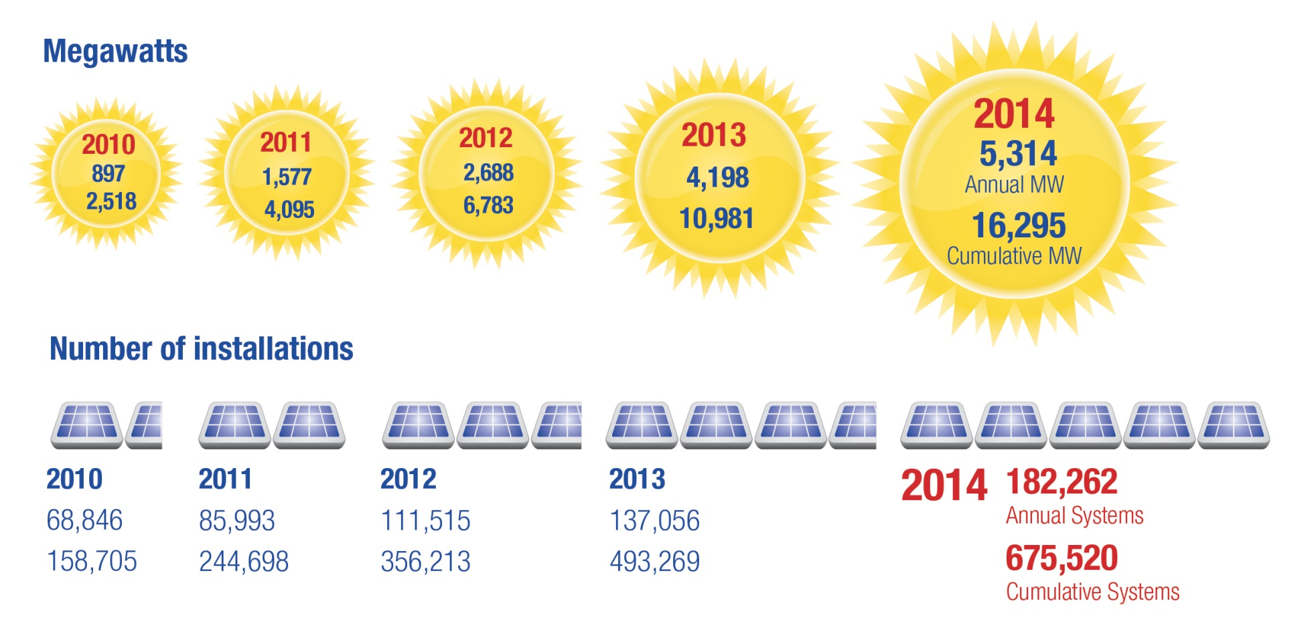
Graphic: SEPA- solar snapshot
Notes:
Stacy-
Every year the amount of solar capacity installed increases. This is a breakdown of the past five years. We expect to add 2015 in the next few months as data becomes available. (Update this slide if 2015 data is available)
4.6 million households
Every few minutes 2 or 4 depending on who you talk to, a new solar system is installed in the US.
Rhone Resch- SEIA stated that the compound annual growth rate in the solar industry over the past eight years 72%/yr. Fastest growing sector of the energy industry.
Solar jobs have increased over 20% in the past few years.

Slide 6
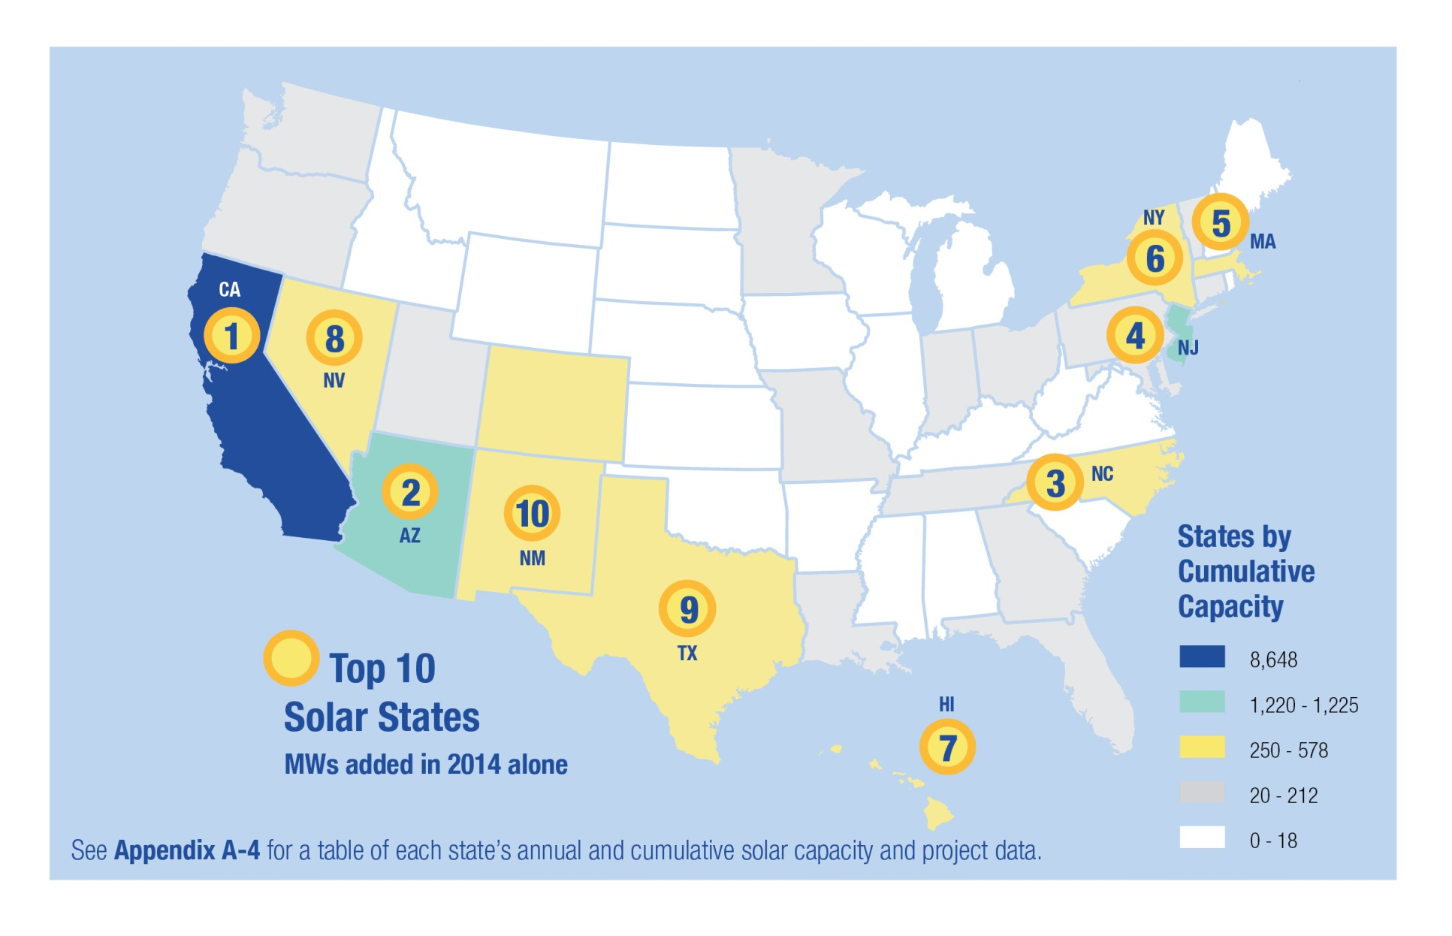
Graphic: SEPA solar snapshot
Notes:
Stacy-/-Paul
This slide shows where the most action is in the country. Other states will be moving into the yellow and from yellow to green over the next few years.
Minnesota should be Yellow after 2016. Growth is happening!
20 states reached grid parity- What is grid parity?
In Hawaii, HECO has 12% of it’s customer base with solar on their homes and businesses, more than anywhere else in the nation.
PG&E in CA has over 20% of all the actual solar installations with over 4.6 GW. (Sunshot 2104)

Slide 7
Challenges for Solar
Cost is still a challenge
Getting the rate structure right
  National debates and regulations in flux
    Net Metering
    Value of Solar
    Regulatory proceedings in high penetration states
      Hawaii, Nevada, California examples
Advanced inverter technology
  Enabling high value services to the grid
Meeting peak demands
Notes:
Talk a little bit about some of the challenges to getting to higher levels of market penetration for solar.
Cost is an issue, but this issue is being solved by competitive market forces, growing global scale, and incremental increases in efficiencies of system technologies and deployment.
Soft Costs are still a big cost component in the US: Explain soft costs (marketing, labor, permitting, interconnections, customer acquisition, etc.)
Highlight national rate structure debates: Net Metering (talk a little bit about PURPA), and talk a little bit about efforts to unseat NEM. Efforts by Murkowski in Alaska to reopen PURPA to amendment, California PUC upholding NEM rates as is, Hawaii eliminating NEM and replacing it with a different rate structure (explain this new structure is there is time), Nevada PUC eliminating NEM with no grandfather clause resulting in a class action lawsuit.
(Let’s consider a slide on the Value of Solar components to point to these values)
Advanced Inverters Discussion: talk about how inverters function now, matching gird voltage, frequency and phase, and may not function when the grid is out of spec, Advanced inverters can continue to operate in New standards for inverter functionality are nearly complete, and when implemented would allow inverters to have more flexibility in how they operate. Adjustable power factor, low voltage ride through.

Slide 8
Challenges for Solar
Consumer Affairs Office
(651)296-0406 or
1-800-657-3782
consumer.puc@state.mn.us
Department of Labor & Industry
(651)284-5069 or
1 (800) 342-5354
Labor Shortages
Permitting
Interconnection issues
Billing issues

Slide 9
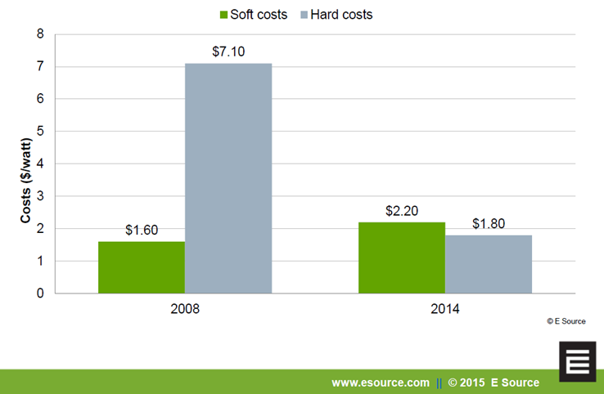
Challenges for Solar
Notes:
Equipment used to make up 80% of the cost of a system up until 2010. Now these are less than half the cost.
Soft costs have actually increased and now outweigh equipment costs of solar.
Process matters—the utility and/or jurisdiction can make or break a solar project.

Slide 10
Federal Investment Tax Credit (ITC)
30% Federal Tax credit for Commercial and Residential systems in service by 12/31/2019
Sunset begins in 2020 for commercial systems
  2021 – 26%
  2022- 22%
  2024- 10% (commercial)
Notes:
Paul
The ITC was recently extended until 2024. Starting in 2020 it will begin to sunset, but a 10% tax credit remains in effect.
For residential, the incentive will drop to zero in at the end of 2020.
The ITC was supposed to expire at the end of 2016. (Talk about the issues this incentive ‘cliff’ has caused in the market place) This had a mixed impact on the industry. It really pushed for 2016 to be a record year as projects were being stuffed into the window of opportunity. This has caused some stress in supply chain, and forecasting of marked drop of in 2017.
The new slower phase out of the tax credits will create a soft landing (at least that’s what’s anticipated)
Modified Accelerated Cost Recovery System (MACRS) is the current tax depreciation system in the United States. Under this system, the capitalized cost (basis) of tangible property is recovered over a specified life by annual deductions for depreciation.

Slide 11
Other Federal Programs
Modified Accelerated Cost Recovery System (MACRS)
  a depreciation tool to take rapid depreciation of solar assets over a five year window
REAP Grants- Rural Energy for America Program
  Up to $2,500-500,000 grants up to 25% of system cost
  Up to $25 million loan up to 75% of system cost
  Agricultural producers and small businesses in rural areas for energy efficiency and renewable energy projects
DOE-Sunshot initiative- driving cost down
Notes:
(Paul)
DOE-Sunshot initiatives: Starting in 2010 after the 2009 signing of the ARRA American Recovery and reinvestment Act. Funding and programs include a goal of 6¢/kwh or $1/w (without incentives). The vision here is to help solar reach an overall market penetration of about 14% in 2030, and 27% in 2050.

Slide 12
Minnesota Renewables
Minnesota 25% renewable by 2025
Solar Energy Standard 1.5% x 2020
New net metering rules
Community Solar
Value Of Solar
Stable Incentives
10% x 2030 Goal
Notes:
Stacy
In 2007 MN passed it’s Renewable Portfolio Standard which requires the IOUs and other utilities in the state to produce 25% of their energy mix from renewable resources in (solar, wind, biogas, hydrogen, biomass, municipal solid waste, landfill gas, anaerobic digestion, and hydro power) by 2025. Xcel energy, the states largest IOU must get to 30% by 2020.
In 2013, MN passed an additional solar carve out (SES) to the RPS, this is on top of the 25%. It requires state IOUs to produce 1.5% of retail energy sales from solar PV. Additionally it requires a 10% carve out of small PVresources under 20kW.
The new SES also increased the caps on net metering from 40 kW to 1000 kW. (Explain net metering)
A portion of the statute was also directed at Xcel energy to establish a Community Solar Garden program. (Explain details of the programs) (Talk about the current status of this program??)
A valuation methodolgy was also to be established for the Value of Solar. (Explain the Value of Solar, and it’s current status or history)

Slide 13
Incentives in Minnesota
Property Tax Incentive
Sales Tax Incentive
Made In Minnesota
Utility Incentives
  Minnesota Power
  Xcel
  Others
Notes:
Property values for taxation purpose cannot include added value for renewable energy systems.
There is no sales tax in Minnesota on equipment and installation for solar
Made in Minnesota incentive overview
Various utility incentives: types and specific programs

Slide 14
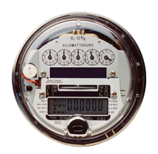
Net Metering
Investor owned utilities:
  Net metering cap raised to 1 MW in 2013
  Single-customer meter aggregation on contiguous property
  No standby charges < 100kW
  Systems 40 kW - 1,000 kW
Notes:
Stacy
IOUs—unchanged for 40 kW and less: Retail rate for excess
40 + avoided cost, no PPA necessary
A staple policy until we get a Value of Solar or something else.

Slide 15
Net Metering
Cooperative & municipal utilities: Changes effective July 1, 2015
  Net metering limit remains 40 kW
  Net metering fees authorized under certain conditions:
    A cooperative …or municipal utility may charge an additional fee to recover fixed costs not already paid for by the customer through the customer's existing billing. Any additional charge must be reasonable and appropriate based on the most recent cost of service study.
  Customers forfeit excess generation at the end of the year unless they elect to receive monthly compensation at retail rate
  Customers interconnected prior to July 1, 2015 unaffected.
Notes:
Cost of Service study is designed as a customer protection. There are specific accepted methods to complete a study. Regulated utilities must do this regularly in order to demonstrate the need for changes to rates. Other utilities
The cost of service study must be made available for review by a customer of the utility upon request.
Any kilowatt-hour credits carried forward by the customer cancel at the end of the calendar year with no additional compensation

Slide 16
Community Solar
Xcel Energy program is the largest
  Minimum of 5 subscribers who must be in a contiguous county.
  A single subscriber may subscribe to 40% of a system
  Subscribers receive on-bill credit
17 co-ops and Moorhead Public Service have community solar programs planned or available now
Notes:
Stacy
Met Council is planning a 756 AC solar garden on its closed Seneca ash landfill in Eagan. They partnered with Oak Leaf who will design, build, own and operate the facility. ES will subscribe to 40% and Transit will subscribe to 40%, the remaining space to be filled by other local governments: Dakota County, Lakeville, and Eagan.
Met Council’s approved closure plan with the County (and PCA) includes vegetation, cover soils, barrier layer, surface water diversion dikes, inlet structures, sediment basin, groundwater monitoring, vermin control. From what I understand pretty standard requirements. Exactly what gets reported might change a bit with the solar panels being installed and we are working through that now.

Slide 17
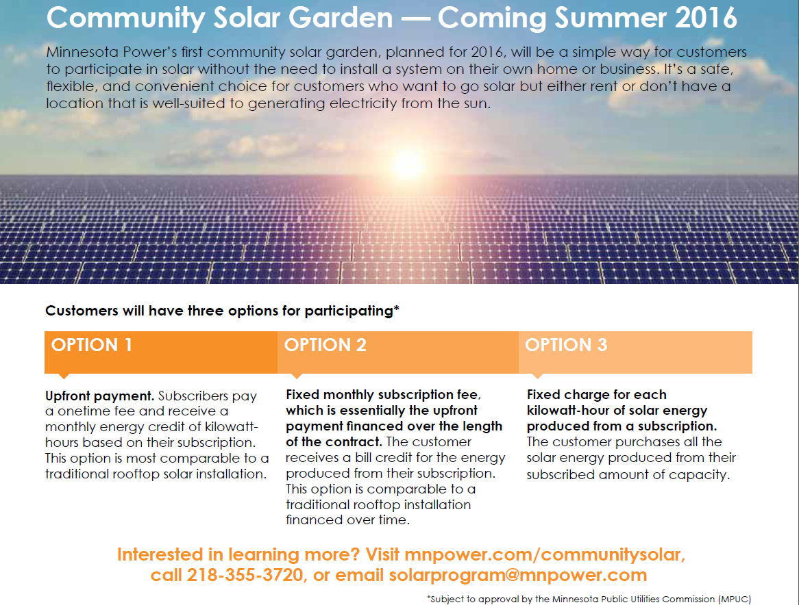

Slide 18
Made in Minnesota Solar
Made in Minnesota PV
  $15 million/year through 2023
  Xcel Energy, Minnesota Power, Otter Tail Power
  Production Based Incentive (PBI)
  Projects < 40 kW Commercial, < 10 kW Residential
  Applications accepted annually Jan 1 – Feb 28
Notes:
Competitive; Lottery system 1:3 chance (Less in MP and OTP)
40 kW Size limits end use

Slide 19
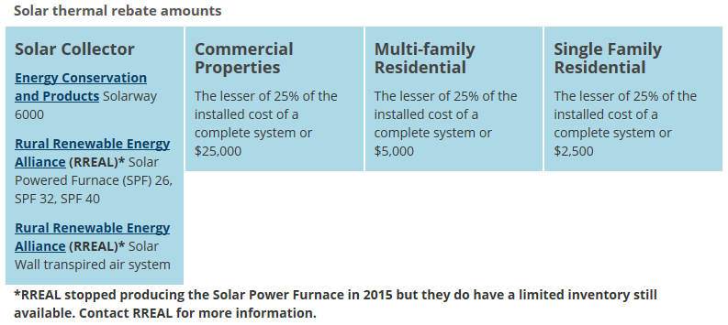
Made in Minnesota 2016 Solar Thermal Incentives
Notes:
No asterisk on second RREAL product

Slide 20
Made in Minnesota Participation Eligibility
Cannot receive a utility incentive in addition to a Made in Minnesota incentive
Must be a customer of an investor-owned utility to participate: Minnesota Power, Xcel Energy, Otter Tail Power
Solar PV
Commercial systems must have a capacity of less than 40 kW and residential systems may have a capacity of up to 10 kW.
Solar Thermal
The solar thermal systems may be installed in residential and commercial facilities for, among other purposes, water heating, space heating, and pool heating purposes. Open statewide if there are unused incentives.

Slide 21
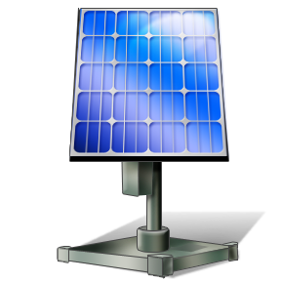
Xcel Energy Solar*Rewards
$5 million annually 2014-2017
Production Based Incentive of $.08/kWh paid annually for 10 years
20 kW maximum
Dakota Electric, Rochester, Minnesota Power, Ottertail Power also have small solar programs

Slide 22
SolarSense
Available for solar photovoltaic (PV) and solar thermal systems
Lottery application process
  Closes February 28th
Solar PV
Capacity-based, tiered rebate
  $750/kW base incentive
  $250/kW NABCEP certified installer
  $250/kW non-profit or tax-exempt customers
Solar Thermal
Rebate of up to 25% of project costs, not to exceed
  $2,000 for residential
  $4,000 for 2-3 family units
  $10,000 for 4 or more family units
  $25,000 for businesses
Notes:
We may add some information, depending on MPUC decisions on what MP has planned for future incentive programs.

Slide 23
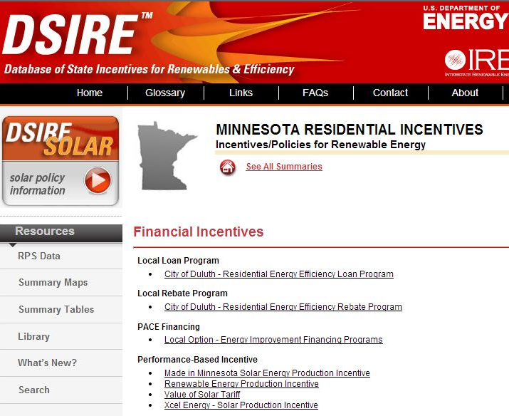
Incentives Database
www.dsireusa.org
Notes:
A list of rebates and incentives for energy efficiency and renewable energy can be found at dsireusa.org

Slide 24
NABCEP Certification
North American Board of Certified Energy Practitioners (NABCEP)
www.nabcep.org
Certification offers the public a high degree of protection because practitioners have to voluntarily meet standards and qualifications and pass an exam.
Requirements for becoming NABCEP certified
  Installation decision making experience and classroom requirements (documented)
  Detailed information for different track available online
Notes:
Paul
Talk about the importance of having qualified installation professionals in the field from sales to commissioning. NABCEP offers certification for installers. Many colleges teach to the standards set by NABCEP.
The certification has different tracks depending on how a person is coming into the industry. The requirements for installation pros include:
18 years old, 58 hours of quaified documented training, payment of fees, and listed requirements from one of 5 categories (A-E) + 10 OSHA training.
The same structure exists for PV tech sales certification as well.
3 year certification- then re-tested
18 hours, CEUs, subject to NABCEP approval

Slide 25
UL Certified PV Installer
IBEW partnership
Requires the passing of an exam based on a set of PV system installation duties and tasks
Must be an electrician and pass OSHA 30 hours training
Valid for three years
CEUs required (6)
Notes:
Established in 2010. was designed to meet and exceed existing industry requirements.
Test is $300, +$25 app fee. 100 questions, 75% to pass

Slide 26
Minnesota Educators
Hibbing Community College Program:
  Solar PV Technician Program
  25 credit course gets you test ready for NABCEP certificate of knowledge
Century College
  Advanced Solar PV Energy Systems
  30 credit requirement
  Tests for NABCEP certificate of knowledge
Notes:
(get more information on Union trainings, as unions are becoming more active in this area of the trade)
(get updated information and materials from the colleges to hand out at the session)

Slide 27
Trends in Technologies and Policy related to solar
Energy Storage
  Technology advancements
  Economies of scale driving down costs (Tesla)
  Complements solar energy systems
Electric Vehicles
  Driving scale for storage technologies
Notes:
Energy storage over the past few years has started to receive a lot of attention. Some major announcements in the industry include the building of Tesla’s Gigafactory which will double global production capacity for Lithium Ion batteries.
2015 was a big year for storage, policy driving storage in California (AB2514) mandates utilities install 1.3GW of storage by 2020, making this a largest procurement target in the world. Oregon has also passed a
Storage is complicated, and still more costly than other choices in most cases, but it holds a lot of promise and has seen some commercial applications coming online.
Storage can offer different services to the grid. Voltage support, frequency support, or supplemental energy supply.
There are many technologies that can be applied to different scenarios. (Talk a little bit about some of the technologies out there like pumped hydro, compressed air, flywheels, electro chemical batteries)
Cost competitive solar with storage would open much larger values for solar, allowing this resource to become more reliable and dispatchable.
Electric Vehicles are an important ‘driver’ for storage technologies, as electric vehicles scale, storage manufacturing and technologies will become more affordable.

Slide 28
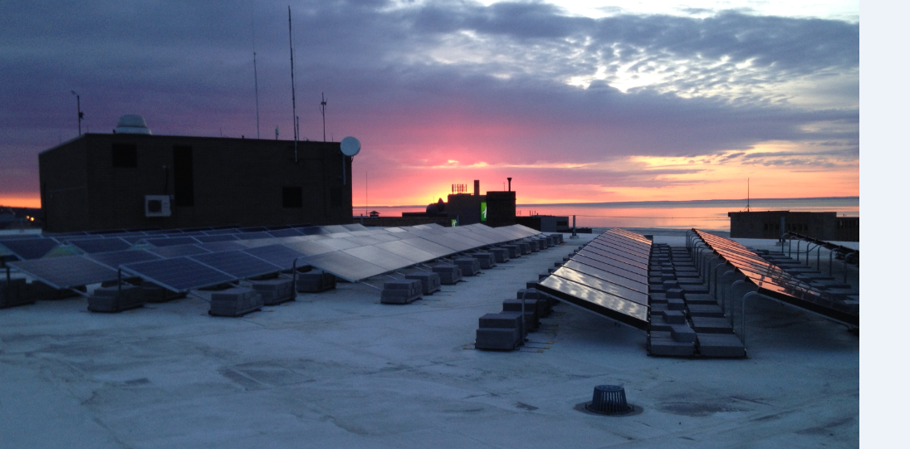
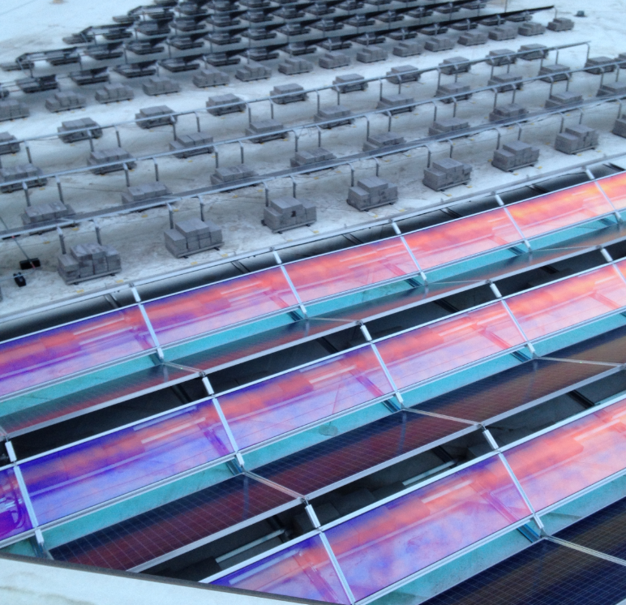
St. Louis County

Slide 29
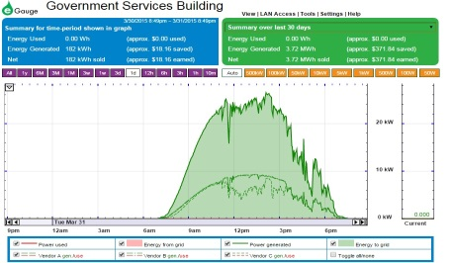
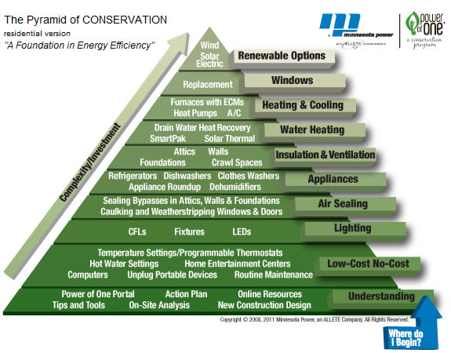
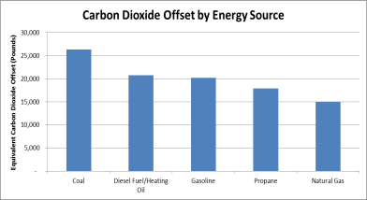
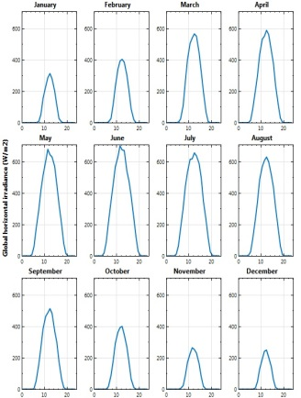
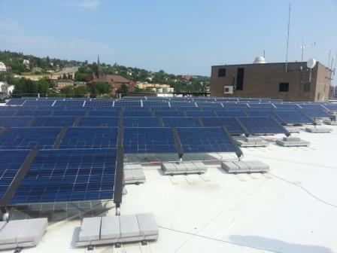
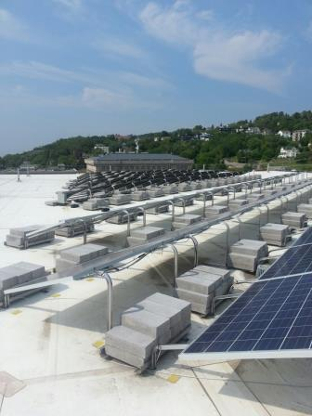
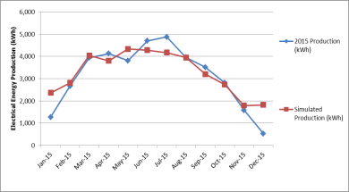
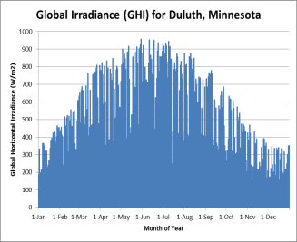
NRRI, Minnesota Power, and St. Louis County Solar Photovoltaic Study
Introduction
Minnesota Power (MP) requested assistance from the University of Minnesota Duluth Natural Resources Research Institute (NRRI) to investigate the performance of three solar photovoltaic (PV) arrays in a Northern Minnesota environment. This project would be a multi-year program to monitor solar system output, reliability, and other factors. Three 10 kilowatt arrays were to be installed on top of the six story Government Services Center (GSC) in downtown Duluth. The data from this study will be used internally at MP and the arrays would be a showpiece for St. Louis County, as well as a component of the pursuit of LEED certification for the GSC. This study would be the final portion of the Pyramid of Conservation, as renewable energy generation generally requires the highest investment. The Pyramid of Conservation is part of MP’s Power of One® Conservation Improvement Program.
Objectives
NRRI’s objective would be to validate and analyze the data from the three solar PV arrays in Duluth, Minnesota. Specifically, MP’s research goals for this research project included topics such as:
Relative performance of arrays in the short and long term.
Correlation of actual data to modeled data in a Minnesota climate.
Generation reaction to weather, e.g., cloud cover and low light situations.
Validate vendor claims in regards to production.
Understand installation methods and procedures.
Performance measured against standard pyranometer measurements
This study was to be an empirical study to investigate actual solar PV performance in a Northeastern Minnesota environment.
Materials and Methods
The physical location of the solar PV installation was on top of the GSC, 325 W 1st Street, Duluth, Minnesota 55802. Annual irradiance and weather data for this location according to the NREL SAM database include:
Global horizontal irradiance: 3.70 kWh/m²/day
Diffuse horizontal irradiance: 1.78 kWh/m²/day
Average temperature: 3.2°C
Average wind speed: 4.7 m/s
Production data was acquired from an E-Gauge system and MV90 inverter data from MP. Weather data was provided by a weather station at the GSC.
Preliminary Results
In 2015 the three solar PV arrays produced approximately 37,763 kWh of electrical energy at a capacity factor of 14.1%. The carbon dioxide offset due to this study was approximately 26,300 pounds as compared to energy production from coal. The actual production data matched the simulated data relatively well except for the months of January and December, 2015.

Slide 30
Thank you! Questions?
Stacy Miller
Solar Policy Specialist
(651) 539-1859
Paul Helstrom
Renewable Program Lead
(218) 355-3270
phelstrom@mnpower.com

Slide 31
Appendix: How solar works

Slide 32
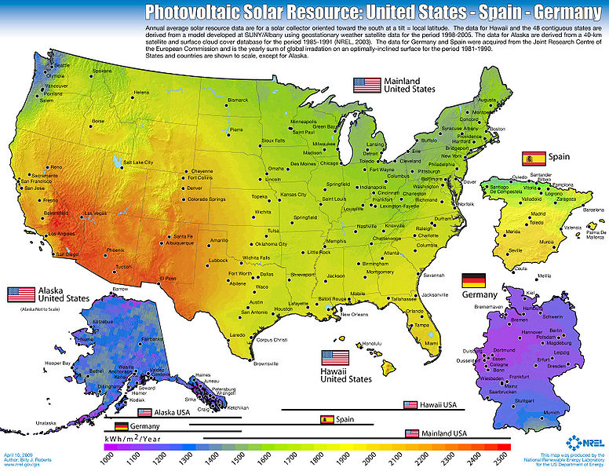
Minnesota Solar Resource
Good solar potential in MN
Solar PV likes it cool and clear
Good installation sites can produce 1250-1350 kWh per year per kWp installed

Slide 33
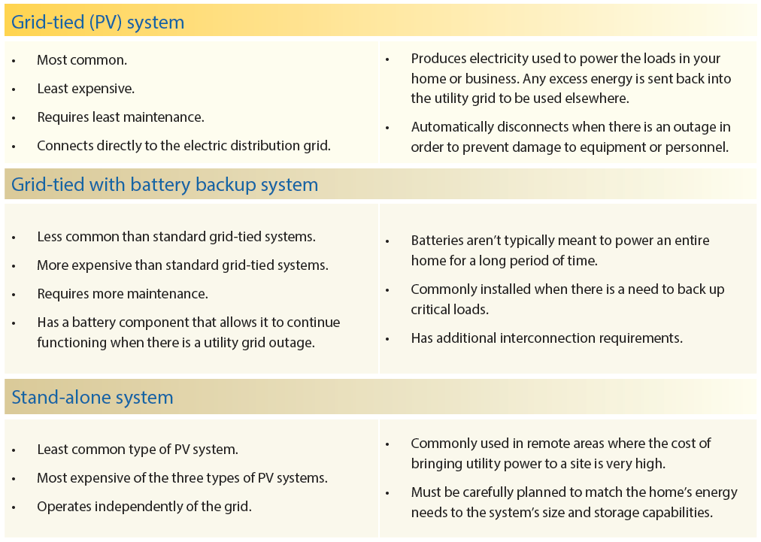
PV Systems

Slide 34
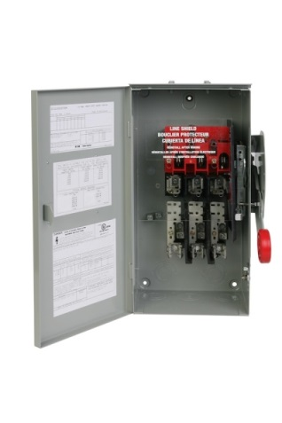
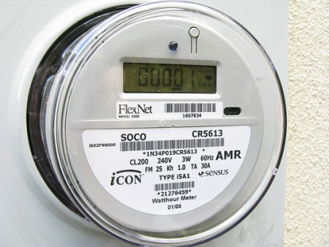
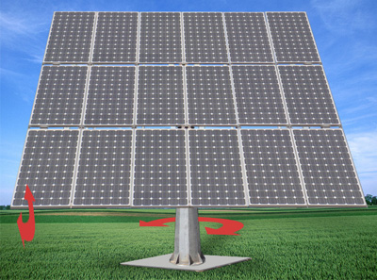
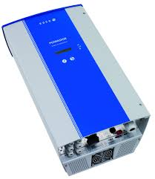
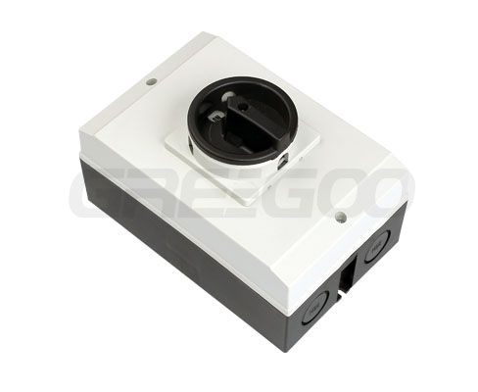
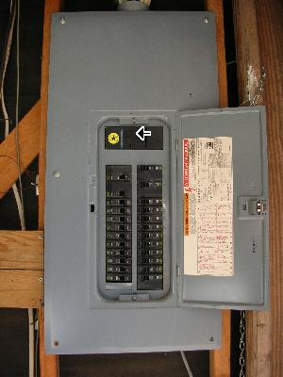
Grid Tied System Components
DC Disconnect
DC
AC
Inverter
Notes:
This is a diagram of a basic grid-tied solar installation – this is what the majority of installations in our service territory currently look like.
Solar thermal diagram, why doesn’t solar thermal need a disconnect, etc.

Slide 35
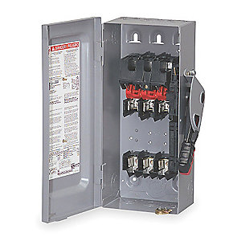
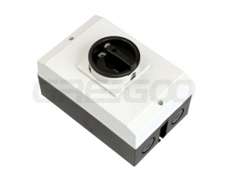
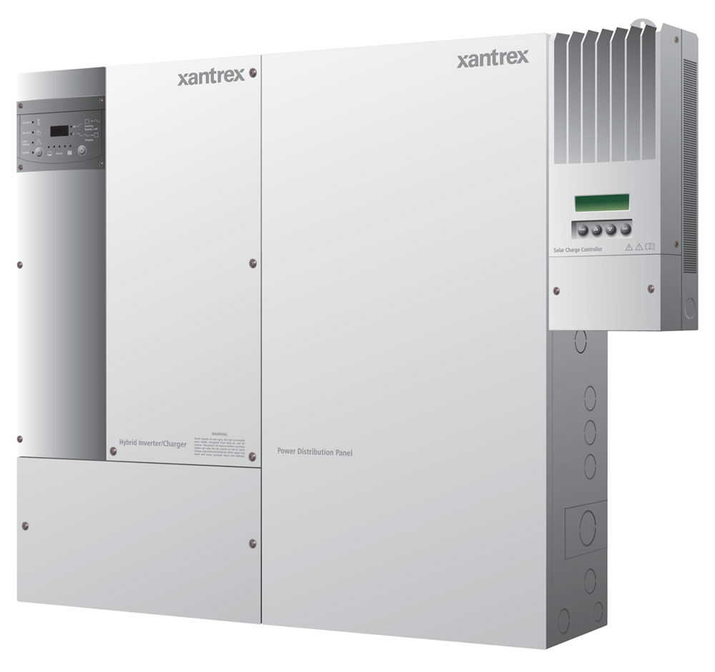
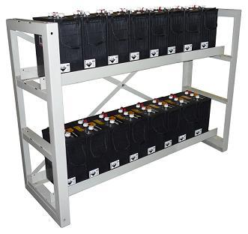
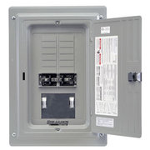
Grid Tied Battery Backup
Main Panel
Solar Backup panel
Charge Controller
Inverter/Transfer Switch
Notes:
This diagram shows a basic grid-tied battery back up system. While we do have some of these installations in our service territory, this is not as common because battery technology is still rather expensive.
Safety reference – bigger concern with battery back-up

Slide 36
Entering the Market
Parties interested in joining the market of solar installation companies should consider:
Skills needed
Tools needs
Services values and expected

Slide 37
Questions?
Paul Helstrom
Renewable Program Lead
(218) 355-3270
phelstrom@mnpower.com

