Slide 1
HVAC Replacement
Case Study
Project Review of the MN Power Cloquet Service Center
VRF research project.

Slide 2
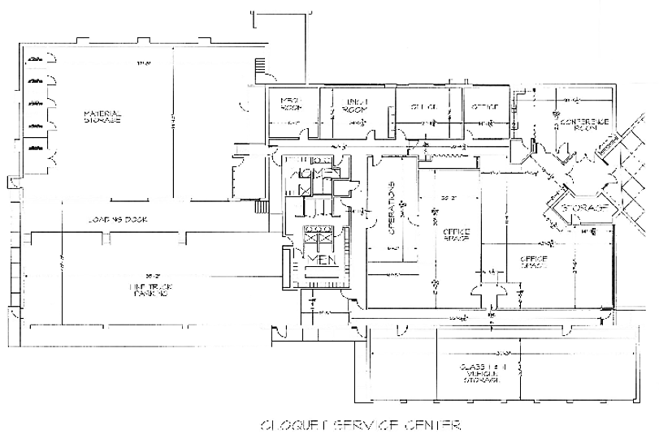
Building Overview
Built:
  1982
Original HVAC System:
  Electric forced air with air conditioning
Building size and capacity:
  19,500 total Sq. Ft.
  9,650 Office Space
  1 Story
MP Service Center

Slide 3
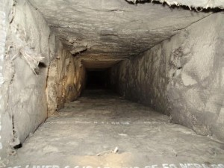
HVAC Replacement
HVAC Replacement
  System is 28 years old
  Internal Duct insulation
Project Scheduled for October 2010
  Regular HVAC designer used for project
  Replace the ductwork
  Initial Replacement Quote – Replace with similar spec. equipment
The project is currently undergoing a recommissioning to correct problems with comfort and efficiency.
Photo By: ductworks.com/wp-content/uploads/2010/03/air-duct-insulation-300x225.jpg

Slide 4
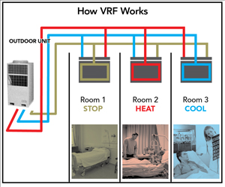
Energy Efficiency Request
Energy Efficiency Group Requested Higher Efficiency HVAC
  Management approved
  Building Manager Agreed
  New type of system – Leading edge technology for the area.
The System - Variable Refrigerant Flow Air Source Heat Pumps.
  Benefits
    Smaller piping
    High Efficiency
    Heating and cooling
    Limited Ducting
Photo By: http://www.buildings.com/techindepth/vrf

Slide 5
Proposals
1st Proposal replace system with similar system.
  Rejected by building owner required higher efficiency system.
Request for High efficiency VRF system by the customer.
  Rejected by the designer said it will not work in Northern MN.
2nd Proposal similar system in addition to high efficiency System
  Rejected proposal because of the cost and 2 complete systems were not required.
3rd Proposal for a stand alone VRF system.
  Requested by facilities manager and energy efficiency group.

Slide 6
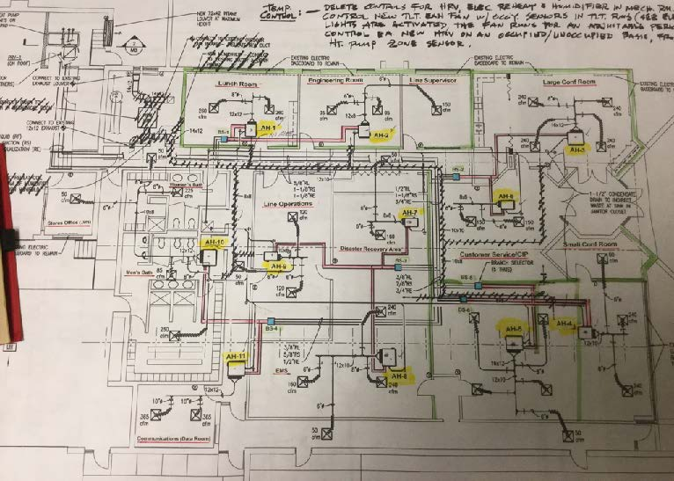

Slide 7
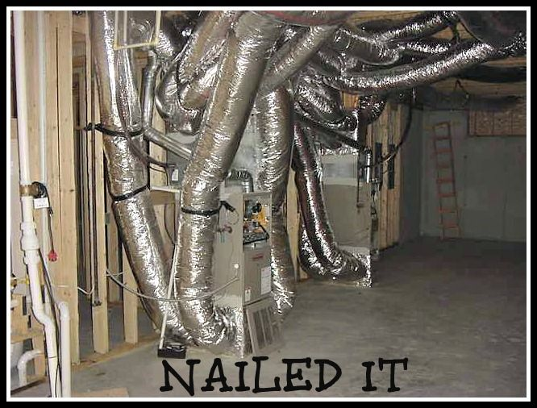
Challenges
Additional Equipment
  Ventilation System
    Duct work was removed
    Make up air
  Heat pumps spread around the building
    Power Requirements
  Expanded Control System
    Communication lines to individual heat pumps and thermostats
  Additional Cost
    Replacement cost for similar system approx. $65,000.
    New system $100,000
https://www.pinterest.com/chels1292/hvac/

Slide 8
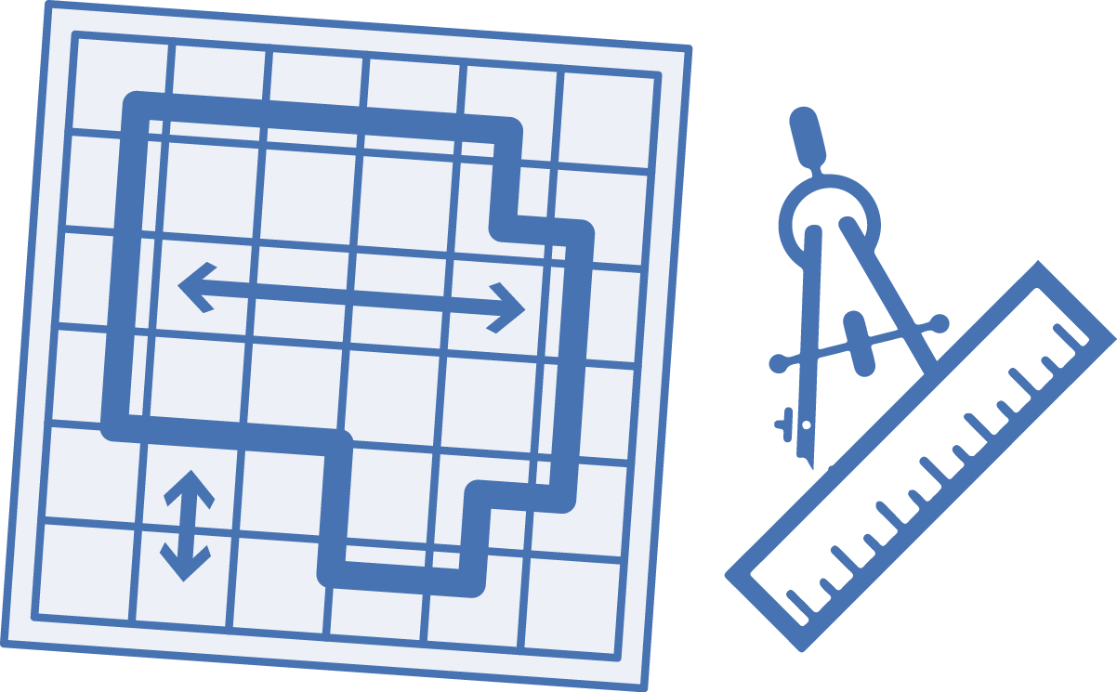
Design Phase
Customer Concerns
  Energy Efficiency
  Cost (Install only one system)
  Controllability (BAS, Energy Efficiency)
Contractor Concerns
  Will it Work in Northern MN (Customer Satisfaction)
  Customer Wish List vs. Standard Practices (HRV’s instead of a MAU)
  Cost (Initial, Long term and Call backs)
  Technical (New system design, what size, how to control…)

Slide 9

Building Comfort and Technical Issues
Problem maintaining temperatures.
Very low humidity from over ventilation
Dry floor drain traps (sewer smell)
Drafty feel when heat pumps are not running
System will not auto switch from AC to Heat
System will fight itself AC vs Cooling (both on)
Communication and control issues
Master and Slave control issues. (Slave set as master)

Slide 10
Design/Installation Issues
Note: Some of the design issues noted may have happened after initial Installation.
Bathroom exhaust only ventilation causes problems in wild plenum
No Dampers on the HRV’s in the office areas
HRV Ducting (Balanced flow, Flexible ducting)
Schedules and settings
Occupancy Variables (all units are on or off)
Garage (Master of Bathrooms)
BAS Controls, Manufacturer and contractor controls (who commands Who)
IT Room Heat Recovery ( Was never achieved)

Slide 11

Costs
Initial Design Costs
  Replacement cost
    Initial replacement costs $130,000
    Call backs (numerous mechanical and control calls)
    Consultants to help with the repairs. $20,000
    Contractor Costs to implement mechanical Fixes $35,000
    Contractor to fix the controls $15,000
  Other Costs
    Higher energy costs
    Local personnel time and comfort
http://wildmorrealty.com/wp-content/uploads/labor-cost.jpg

Slide 12

Could this have been prevented?
Design Phase
Goal requirements agreed upon.
  VRF system for 100% heating and cooling (can it be done?)
  Programing, schedules and control
  Ventilation Requirements
  Energy Efficiency
  Maintenance schedules and equipment
  Change orders ( Impacts of changes )
https://www.yos.org/sites/www.yos.org/files/assets/prevention.jpg

Slide 13

In-Depth Design
How much more will it cost?
How much longer will it take?
Do customers see the value up front?
Will better design result in less call backs?
Will we have more energy efficient buildings?
Will In-Depth design with the Contractor, Building Owner and Maintenance reduce call backs?
http://www.mavinconstruction.com/wp-content/uploads/2012/09/pre-construction-meeting.jpg

