Slide 1
DAIKIN APPLIED
HVAC Design Discussion

Slide 2
Select Vertical Market Trends

Slide 3
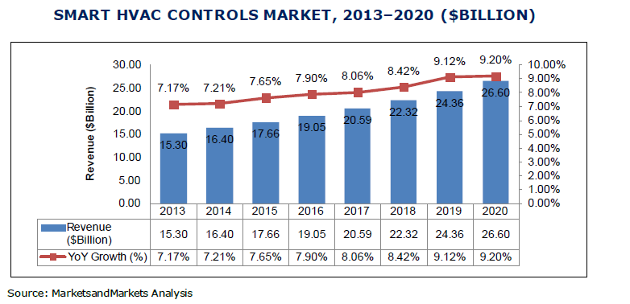
Market Opportunity
5.6M Comm. Bldgs N.A.
94% of all bldgs. ≤50Kft²
75% lack Traditional BAS
3.9M building
Complex Market
Mid-Small
$27B Market
*2012 CBEBC Survey U.S. Commercial Buildings

Slide 4
Construction Forecast - % Change in US Dollars
Total non-residential construction starts forecast at 9.1% for 2016
    Projections updated Feb 29, 2016

Slide 5
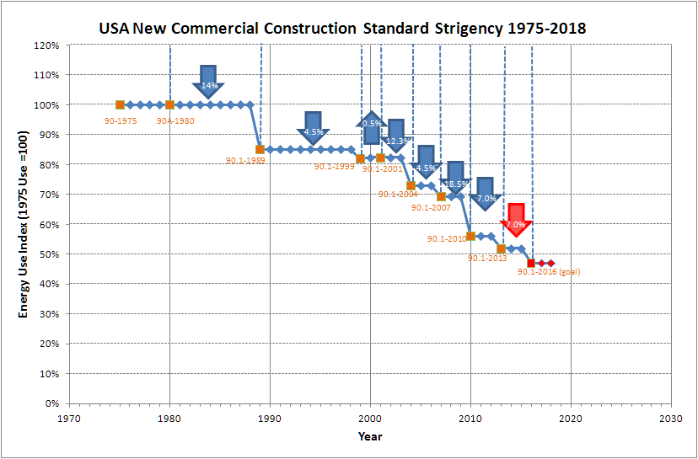
Historical Efficiency Improvements
Significant progress has been made in improving the energy efficiency of buildings and HVAC Equipment
USA New Commercial Construction Standard 1975-2018
2016 90.1 Goal :
7% building efficiency gain over the 2013 standard
50+% improvement since 1989

Slide 6
HISTORICAL BUILDING LIFE CYCLE COST

Slide 7
POTENTIAL BUILDING LIFE CYCLE COST

Slide 8
30 YEAR HVAC LIFE CYCLE COST EXAMPLE
ROOFTOP UNITS
Initial Investment $1,267,855
Replacement Cost $762,191
Annual operational cost $8,256,989
Total life cycle $10,287,035
4 PIPE CENTRAL PLANT
Initial Investment $2,971,000
Replacement Cost $257,000
Annual operational cost $3,831,876
Total life cycle $7,060,504
Life Cycle Cost Difference
$3,226,531

Slide 9
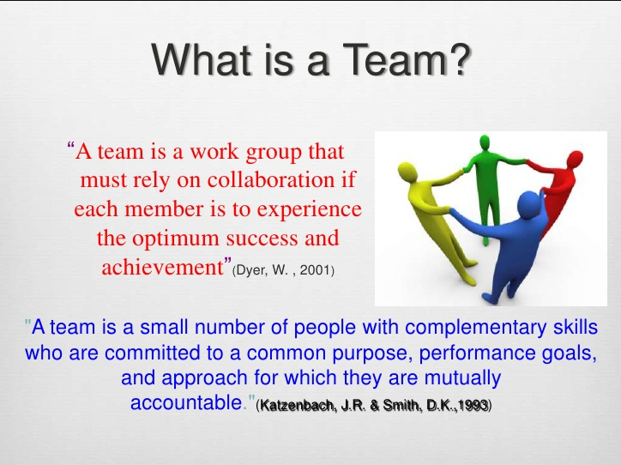
Foundation of Success

Slide 10
TRADITIONAL DESIGN PROCESS
Architect
Owner
Contractors
Specialist: Lighting, IAQ, HVAC, Acoustics, Fire, Security, Communications, Energy, Utility Rep, Commissioning
Engineers
Cost Consultants

Slide 11
INTEGRATED PROJECT DESIGN TEAM
Team Lead
HVAC
IAQ
Acoustics
Fire
Communications
Security
Contractor
Commissioning Agent
Lighting
OEM Partners
Building Engineer
Utility Rep.

Slide 12
ADDITIONAL TEAM MEMBERS
Utility Provider
Financial Partner
Tax Specialist
OEM Partner
Water Treatment

Slide 13
Post Installation Considerations
Post Project Documents
  Document model and serial numbers of all equipment
Training, Training, Training!
  Factory training and on going training is critical for success
Maintenance Program
  Find a factory trained trusted advisor
Recommissioning Program
  Keep the systems operating optimally for best performance

Slide 14
Maintenance programs
Reactive
  Fix on fail approach
  Average cost approx. $18 per hp. per year
Preventative
  Scheduled tasks per manufacture with critical software updates
  Average cost $13 per hp. per year
Predictive
  Thermal Imaging
  Eddy Current Testing
  Vibration Analysis
  Average cost approx. $9 per hp. per year

Slide 15
value of Predictive maintenance
Return on investment - 10 times
Reduction in maintenance cost – 25% to 30%
Elimination of Breakdown – 70% to 75%
Reduction in downtime – 35% to 45%
Increased production – 20% to 25%

Slide 16
Energy Recovery Rooftop Unit

Slide 17
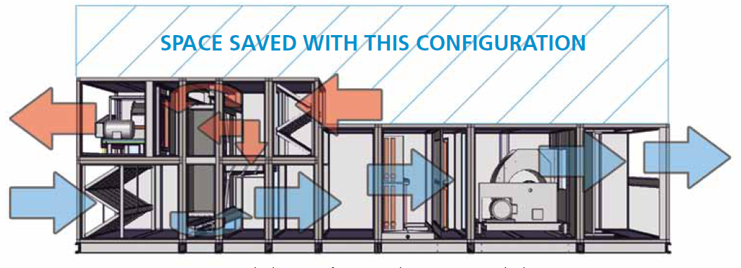
Leed gold school project
Dual Height Energy Recovery AHU – Daikin Applied Custom
Challenges
  LEED Gold
  Over Budget
  Forced Custom Approach
Partnership Results:
  LEED Goals Met
  Budget Goals Met
  Customer Expectations Met

Slide 18
Variable Flow Verses Constant Flow
Best improvement to a chiller plant is variable flow
  Required by Std 90.1, 189.1
  Std 90.1-2010 6.5.4.1
  Over 75 hp
  More than 3 control valves
Lowers capital cost of piping and pumps
More complex

Slide 19
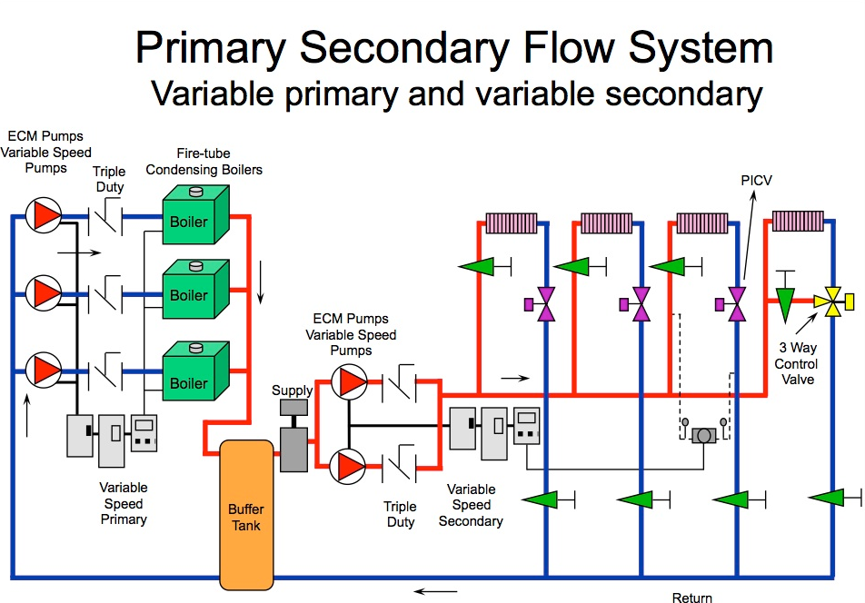
HEATING Plant

Slide 20
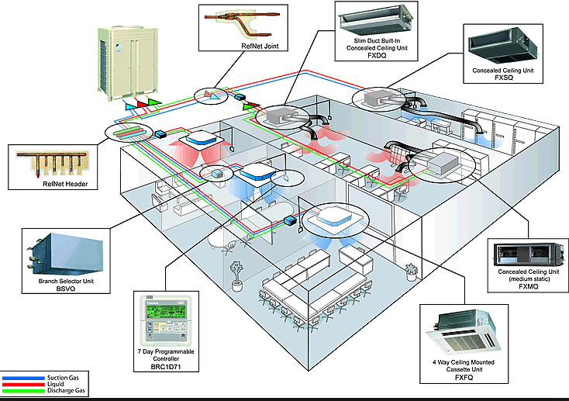
EMERGING TECHNOLOGIES

Slide 21
INTELLIGENT Building CONTROLS

Slide 22





External/Influencing Factors
Environmental
Aging Power Grid
Technology
IoT
Profit Pressure

Slide 23
IoT Definition and Principles
1.
Edge to Cloud:
Delivery of services across the enterprise,
across the globe. Compute and comms close to the edge, but securely cloud connected.
2.
Mobility:
Ability to visualize interact anywhere on the planet.
Cell phone,
Tablet, PC.
3.
Analytics:
Based on sensed world, provides analysis and insight.
Anticipation
of needs.
4.
Security and Manageability:
Connects securely to “things” in the built world, in a trustworthy fashion.
Data, Security, Management.
Quality of Service.
5.
Collective Relevance:
Meaningful to a community.
More than one person benefits.
Example: Buildings anticipate and respond to
occupants’ presence and preferences.
©2015 Daikin Applied
Notes:
Most discussions of I O T, or the Internet of Things start with some “edge to cloud” process sketch where 1) “Things” in the built world are imbued with computing intelligence and connected to one another toward the goals of more insightful services, more efficient operation, and more holistic cooperation among one another; 2) These streams of information are brought together through network infrastructure, toward a cloud data center consolidation point where insight, thru analysis may take place, and 3) The analysis creates meaningful insights that can drive more value than the thing can on its own.
IOT has become such a buzz-word as to almost become cliché…so we feel its important to spotlight the principles Daikin and Intel have defined that uniquely describe the values of IOT…
There are 5 key principles that constitute modern Internet of Things solutions:
Edge to Cloud- Services are delivered across the enterprise at the network edge from the cloud and back again.
Mobility- So no mater where you are in the enterprise or on the planet, you can connect to this IoT solution from your Smart Phone, your Tablet, your PC or wherever.
Analytics- since IoT is driven from and thrives in a sensor-rich environment, its all about the Analytics. Making sense of sensor data and using this sensor network to predict and anticipate what is going on.
Security & Manageability- With all this global access and critical sensor data, the system better be pretty darn secure. These IoT solutions are becoming mission critical, … so access to the network, and ability to run code at the edge or in the cloud, or to even be considered a “sensor” on the network must be ‘locked down’ to only those Trusted and authenticated elements.
Collective Relevance- and lastly, the point of this all is to deliver something meaningful to a community… to be relevant to more than just a single individual. Even the google maps smart phone app not only delivers route information to the individual user… but it aggregates location information across all users to analyze and visualize route congestion and better alternatives. The whole community of users benefits!
So for another example… an IoT Enabled Smart Building would sense the people occupants in a building and know their location. Any one of these individuals might wish to inquire via their Tablet of Smart Phone where an open conference room is for an impromptu meeting. Rooms that had been previously booked, but are sensed to be unoccupied would have been put back into available inventory and served up as options to our inquisitor. Instantaneously booking the room causes the building control system to adjust the space to lighting and temperature and air circulation preferences that are attached to the profile of our new room occupant… adapting to personalized preferences.
So the building is anticipating and responding to the presence of occupants and their needs and preferences according to business rules.

Slide 24
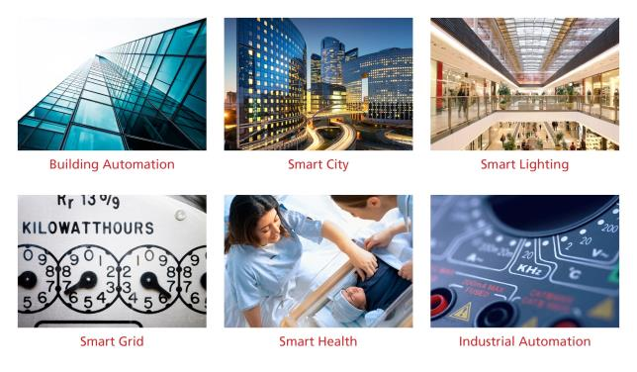
Connecting Real Estate (IoT) to Real Value
GE estimate: the “Industrial Internet” has the potential to
add $10 to $15 trillion to global GDP over the next 20 years *
2015 Commercial Building Automation Systems Revenue estimated at $68 billion
2015 BEMS revenue estimated at $2.4 billion**
Smart HVAC controls market will grow
to $26.6 billion with a 9% CAGR by 2020! ***
Big data is the value!
* Forbes.com: “Internet of Things by the numbers, market estimates and forecasts,” by Gil Press. August 22, 2014.
http://www.forbes.com/sites/gilpress/2014/08/22/internet-of-things-by-the-numbers-market-estimates-and-forecasts/
** Navigant Research *** Markets and Market.
Notes:
The opportunity is huge. Just in US, China & EU, there are 200M C&I buildings by 2018.
Technologies that include hardware, software and services are estimated to be a $21B opportunity for the ecosystem.

Slide 25
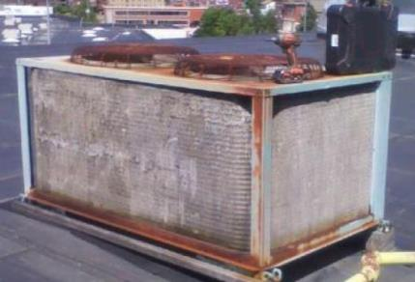
Why Is This Relevant to You Today?
40% of a building’s energy consumption is in HVAC systems
Investment in HVAC equipment lasts ~15 years
Within the next 5 years, 60% of all rooftops will be replaced
Small-mid-sized enterprise owners have a significant share of these units
Image source: http://contractingbusiness.com/galleries/danger-expense-stupidity-my-work-here-done-updated-wall-shame-photo-gallery#slide-0-field_images-22041
18
Notes:
Rooftop systems are easy to neglect – without a facility manager, they are out of sight, out of mind. So their efficiencies plunge. And the building occupants tend to think of it like a car engine, if it’s running, it’s fine.
But for building owners, these are decisions you live with for a long time

Slide 26
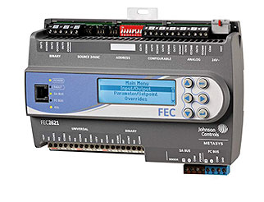
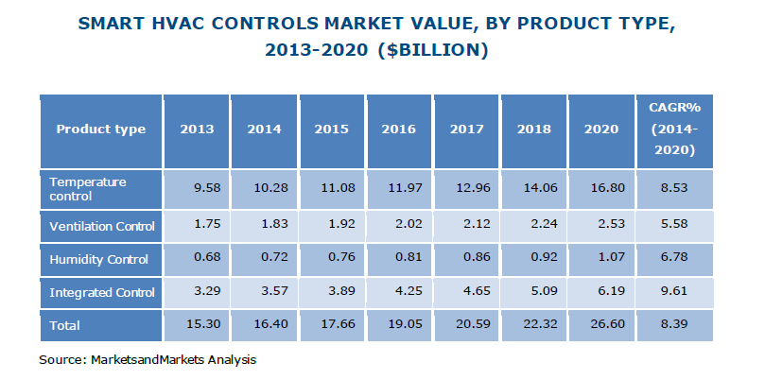
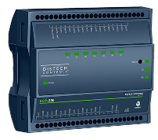
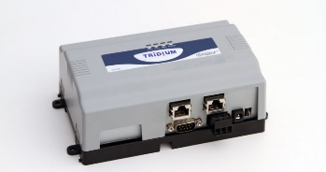
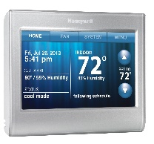
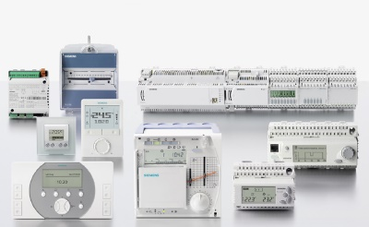
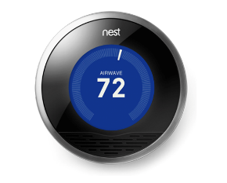
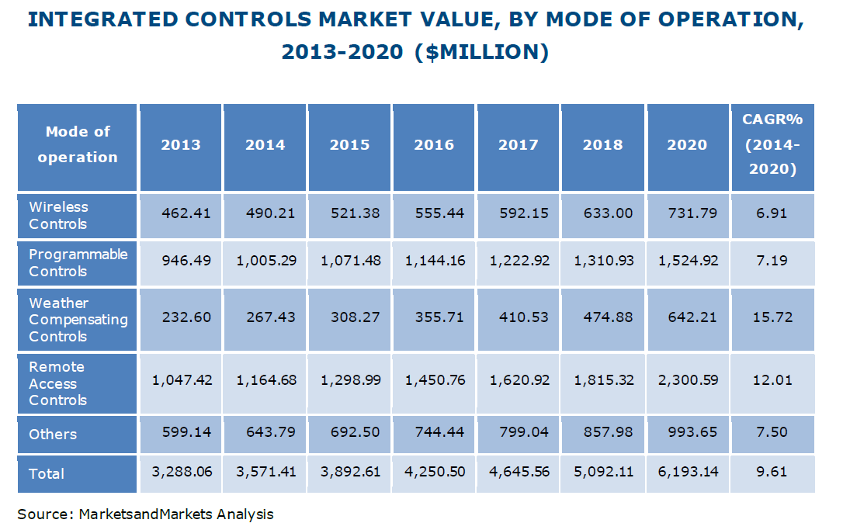
Market Opportunity
Current Solutions
Option | $$ Range
DDC System (Lite to Mid-sized) | $65K - $110K
Smart Stat | $350 - $750
Hard-wired T-Stat | $100 - $300
Notes:
Assumptions
Hardware and Software ($37.5K - $65K)
PC Workstation/ Hardware: $5K
Front End BAS Software: $10K - $15K
Licensing Fees $0K – $2.5K
Zone /Terminal Box Controllers: $10K - $20K
Primary / Supervisory Controllers: $10K - $20K
Network wiring: $2.5K - $4K
Programming ($19.5K - $30K)
Point Database Setup: $12.5K – $15K
Graphics Package (web pages): $7K - $15K
Labor ($8K - $15K)
Installation Labor: $3K - $5K
Start Up Labor: $3K - $5K
Operator Training: $2K - $5K
Material (Stat): $200 - $250
Installation Labor: $75 - $125 / Hr
Total Install & Configure Time: 2- 4 Hrs
Material (Stat): $20 - $50
Installation Labor: $75 - $125 / Hr
Total Install Time: 1- 2 Hrs

Slide 27
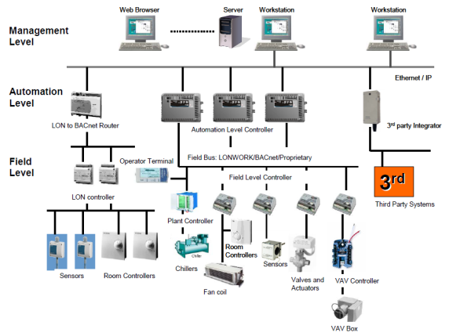
Today’s solution…..
BMS Firm | Typical Installed BMS Price
Company “A” | $77K/270 Hrs
Company “B” | $81K/290 Hrs
Company “C” | $90K/319 Hrs
Company “D” | $85K/303 Hrs
Company “E” | $63K/223 Hrs
…is Expensive!
…is Complex!
Traditional BMS Systems have High Initial Cost, Complicated Integration and are Costly to Maintain

Slide 28
Building owner needs

Slide 29




Large square footage building staff includes:
① Building managers
and operators
② Vendors who support them
③ Business managers who occupy the buildings
④ Vendors and customers that support the occupant businesses
Notes:
Large buildings have four types of people coming and going each day:
Building managers and operators
Vendors who support them
Business managers who occupy the buildings
Vendors and customer who support that occupant businesses.
So large buildings have dedicated teams who are trained and knowledgeable facility managers who operate the building as an enterprise. They know how to use the BEMS.

Slide 30
Small to mid-size building staff includes:
③ Business managers who occupy the buildings
④ Vendors and customers that support the occupant businesses
  Their need for managed service and advanced technology is actually greater
Notes:
Small to mid sized buildings don’t have that advantage. There is no dedicated team at the building or remotely to operate it. Occupants and visitors are charged with the basic functionality – security system, thermostat, turn the lights off at the end of the day to keep their costs down. They don’t have any insight or responsibility for the aging HVAC equipment on their roofs. They are not trained facility managers, and they’re understandably NOT focused on managing the building mechanicals, which would require them to direct their attention and resources away their businesses.
And that’s the paradox: without a BEMS, and without facility managers, owners of small to mid-sized building enterprises actually have a greater need for managed services and advanced technology to bridge the gap left by complicated, difficult to use BEMS and no support staff.
Also there are staff members who show up at the building every day to operate the building through the system
Need to add user profiles and distinctions in user experience

Slide 31
Building Owner Ecosystem
Commercial Ecosystem
Requirements
Flexible & economical –needs will vary by vertical
Smaller buildings don’t mean less capability desired
End users need value and ease of use
Ease of installation
Controls
HVAC
Services
Utilities
Security
Fire
Bldg Portfolio

Slide 32
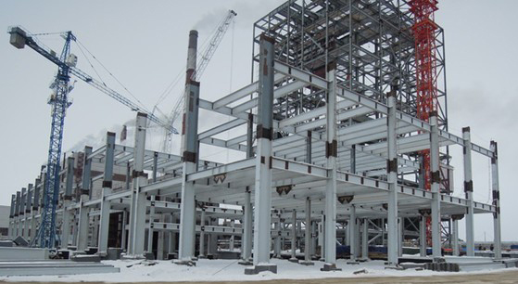
Building an Intelligent Control Platform
Platform - Definitions & Synonyms:
  A load-bearing structure
  A flat surface to provide support
  A foundation
The IE platform makes it possible to bring
  new capabilities into our equipment
  Preventative Maintenance
  Recommendations
  Financial Metrics
  Operational Data
  Predictive Failure
The IE platform:
  provides a means to transfer information to and from BASs & other building systems
  gives us new ways to deliver meaningful data to our partners and customers
  will extend to all Daikin HVAC equipment
  capabilities will become the “new normal” for HVAC machines

Slide 33

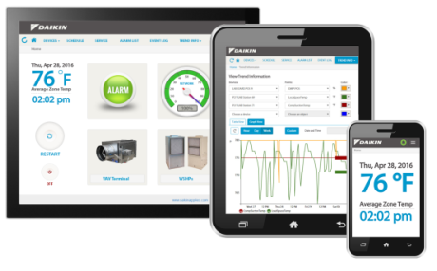
Introducing Intelligent Systems
Microtech® Integrated Systems
Intelligent Equipment®
Daikin’s Intelligent Systems platform
meets the needs of Digerati
Notes:
Daikin Applied has integrated digital technology into our Intelligent Systems to help your firms drive value and competitive advantages for your customers.
Microtech’s INTEGRATED SYSTEM IS a “plug and play” solution THAT Integrate S and optimizes HVAC equipment at the building level
MIS Transforms HVAC SYSTEM IMPLEMENTATION AS WE KNOW IT.
Intelligent Equipment's Cloud connected SOLUTION is a completely new concept for HVAC Control.
Intelligent Equipment transforms equipment management as we know it
I’d like to tell you a little more about both solutions.

Slide 34
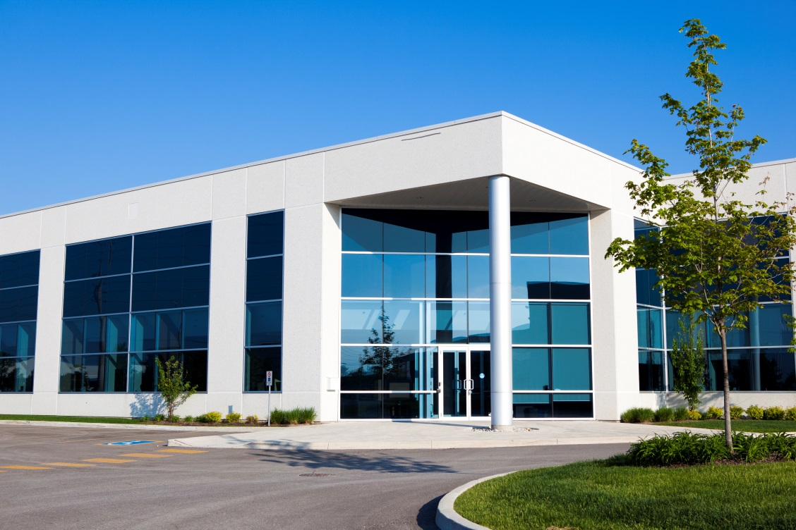
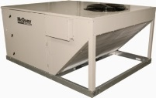
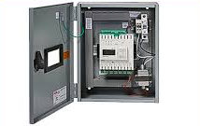
Traditional HVAC System Implementation
Notes:
In a traditional implementation, the HVAC equipment and controls arrive to the site separately, and are installed by different companies.
The system is built up and custom designed by different parties, customized on parallel paths and matched at the site.
It’s harder work to figure out how its all going to come together. It becomes an expensive process, subject to many opportunities for error.
We asked ourselves; Operationally, does this make the most sense? How can we improve this? How can we do this differently than our peers?

Slide 35
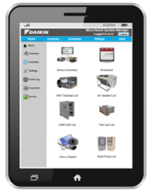
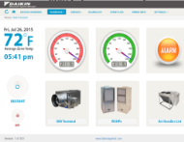
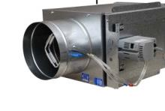
Intelligent Systems
Notes:
With Microtech Integrated Systems, this work is done up front, at the factory. We provide a packaged solution – so the equipment, building controls and all the programming are integrated by the factory, not on site by separate parties. The value is in pre-engineering the solution, coming from the factory ready to go.
To make this really concrete: In a less integrated system, a rooftop’s duct pressure set point might get set for the worst case scenario.
But MIS’s duct pressure reset control looks at all the damper positions for all the VAV boxes in the spaces, and continually drives the rooftop’s duct pressure set point down.
At a system level it optimizes the fan speed and compressor energy to minimize the cold air that’s needed to satisfying the building load at any point in time.

Slide 36
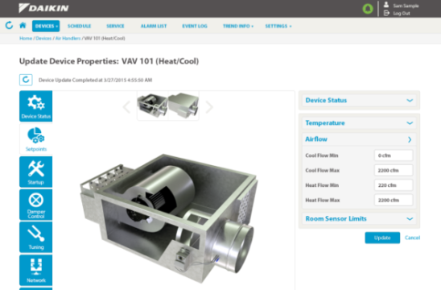
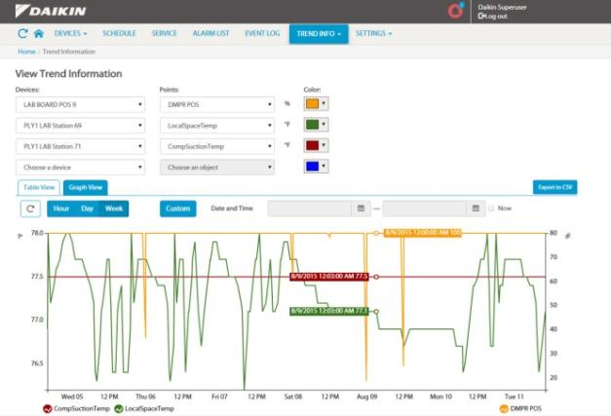
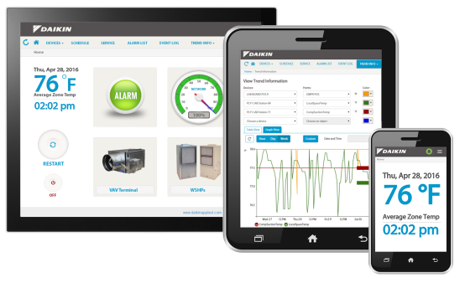
Microtech Integrated System Benefits
Centralized:
  Control
  Monitoring
  Scheduling
  Alarm indications
Remote/mobile access and alarm messaging
Graphical trend data
Energy saving algorithms
Equipment coordination
Notes:
MIS is for buildings in the light commercial HVAC space exactly what the light bulb with software-enabled features is: MIS does with software what the BAS cannot do, replacing the physical efforts of field addressing devices, assigning VAV boxes and other terminal devices to physical locations and tagging equipment in the software – all in addition to providing the same functions that a BAS does: monitoring & control, equipment scheduling and alarm monitoring/management.

Slide 37

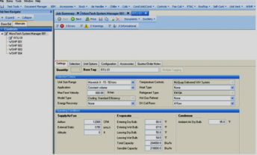
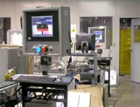
MIS - Putting System Information to Work
Save Time at the Job Site
Faster System Start-up
Faster Commissioning
System Designer’s Schedule
Daikin
SelectTools™ Program
Programmed & preloaded at the factory
Creating high performance buildings with a pre-packaged solution
Notes:
This is hardware and software working together to minimize energy consumption and maximize comfort
The transformation comes in the ability to manage the cost to implement, and the risk associated with integrating a facility
We pulled the physical labor out of the field and put it into software
This digital intensity creates high performing buildings out of even the smallest facilities at a fraction of the cost of BAS

Slide 38
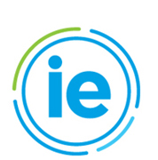
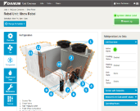
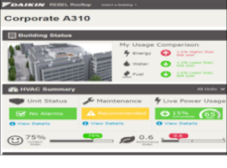
Intelligent Equipment: Creating Value from “Big Data”
Notes:
Let’s shift gears for a minute to Intelligent Equipment, Daikin’s first implementation of Machine to Machine communications (M2M), giving us new ways to deliver meaningful data to our partners and customers.
Intelligent Equipment connects HVAC equipment to the internet and to the building’s authorized users – like the facility manager, building owner and even the service technician. Connection to the internet allows the system to push and pull a large volume of data between the cloud and the system.

Slide 39


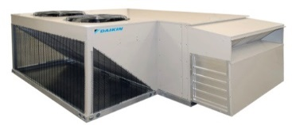
Intelligent Equipment: Creating Value from “Big Data”
Notes:
Connection to the internet allows the system to push and pull a large volume of data between the cloud and the system. It works like this:
Intelligent Equipment pushes system data securely into the cloud
The cloud aggregates it with critical external data (from sources like Energy Star, utilities, weather, for example)
Intelligent Equipment analyzes the consolidated data and pulls it back into the HVAC system to optimize system performance
By combining a gateway (hardware and sensors installed on each individual HVAC unit) AND a software program, we can convert big data into actionable intelligence to your customers’ empower decision making.

Slide 40
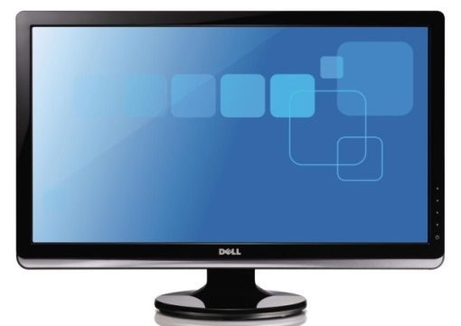
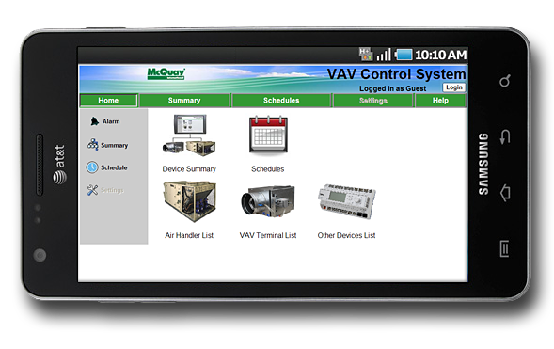

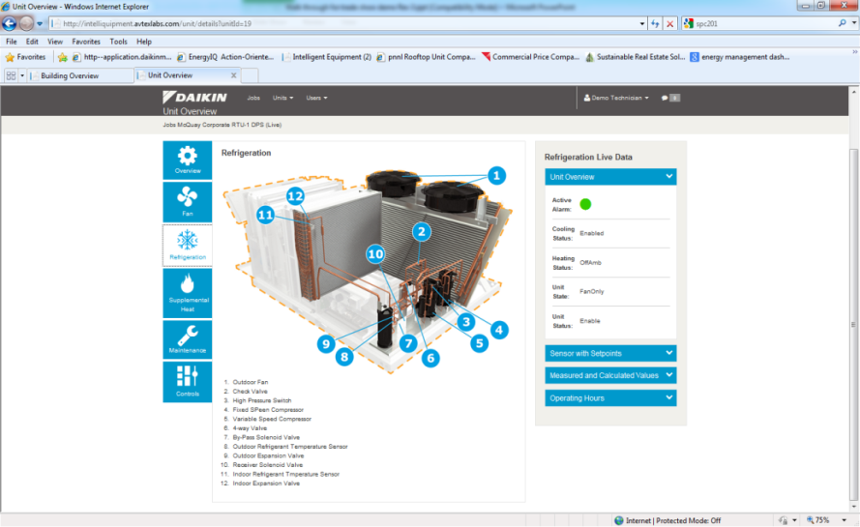
Intelligent Equipment Dynamic Dashboards
Owner/Tenant Dashboard
Technician Interface
Intuitive graphical interface surfaces relevant data for building owners and technicians, remotely on any connected device
Notes:
Building owners and operators AND designated service technicians can read exactly the points of data they want through an intuitive graphical user interface

Slide 41
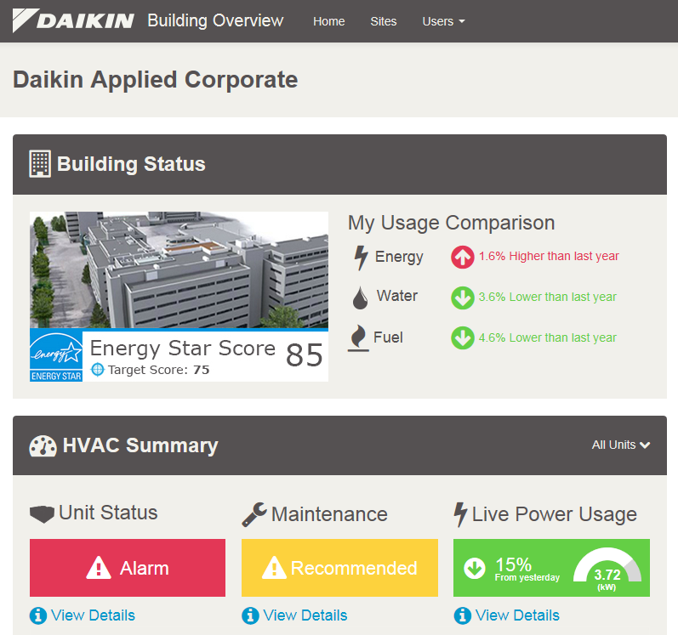
Shifting Attention to Total Building
Holistic approach to
TOTAL BUILDING PERFORMANCE AND
SYSTEM EFFICIENCY
ADVANCING TECHNOLOGY to meet
today’s demands, deliver efficiencies
to the bottom line and
match future energy needs
Services and support designed to
MAXIMIZE BUILDING OPERATION, 24/7
Notes:
We’re excited to be able to share our controls offering with you as an example how Daikin is driving our whole business strategy around increasing building efficiency, bundling market leading equipment with advanced technology, controls and service to set new standards for operational efficiency.

Slide 42
Three Things to Remember
    Hardware + Software = Greater Value
    Data Yields Insights for Competitive Advantage
    Sometimes a $60 Lightbulb is worth it!
Notes:
In closing, I’d like to offer just three things to remember:
READ LIST
Thank you.

Slide 43
Thank You

