Slide 1



Slide 2
Important Stuff
In accordance with the Department of Labor and Industry’s statute 326.0981, Subd. 11,
“This educational offering is recognized by the Minnesota Department of Labor and Industry as satisfying 1.5 hours of credit toward Building Officials and Residential Contractors continuing education requirements.”
For additional continuing education approvals, please see your credit tracking card.

Slide 3
Presenters
Terry Webster
    Project manager for Clean Energy Community Awards
    Minnesota Department of Commerce, Division of Energy Resources
John Paulson
    Project/Environmental/Regulatory Manager, City of Hutchinson
Fernando Nacionales
    Deputy Base Civil Engineer, 133 Civil Engineer Squadron, MN ANG
Patrick Shea
    Director of Public Services, City of St. Cloud

Slide 4
What is CECA?
The Clean Energy Community Awards are an acknowledgment of the work done by Minnesota communities to further the state’s clean energy goals
by implementing programs, policies, and technologies
that encourage energy efficiency, conservation, and renewable energy generation.

Slide 5
Minnesota Clean Energy Goals
Minnesota Next Generation Energy Act
Renewable Electricity Standard
Solar Electricity Standard
Petroleum Replacement Goal
Biofuel and Biodiesel Content Mandates

Slide 6
Why CECA?
Many programs evaluate important metrics
  kWh/therms/water saved
  Progress in efficiency over time
  Financial paybacks
  Number of participating households/businesses
Not a replacement for more rigorous programs
  Adjunct and feeder for other programs

Slide 7
Why CECA?
CECA provides public support for communities
  Recognizing efforts of communities and leaders
  Demonstrating the benefits to communities
  Offering opportunities for public engagement
  Positive media coverage

Slide 8
What is a CECA community?
Communities can consist of any group united in implementing clean energy goals.
  Must include a unit of government
    City, county, tribe, school district, state or federal agency, or other jurisdiction
  Business, nonprofits, service organizations a (big) plus

Slide 9
Possible Initiatives
Initiatives may include the following…
  Clean Energy Planning
  Efficiency in Public Buildings
  Efficiency in Public Infrastructure
  Efficiency in Private Buildings
  Clean Energy Generation
  Transportation
    Others will be considered

Slide 10
Possible Initiatives
  Clean Energy Planning
    Comp plans
    Zoning
    Permitting
    GESP
    B3

Slide 11
Possible Initiatives
  Clean Energy Planning
  Efficiency in Public Buildings
    Shell improvements
    Lighting upgrades
    Efficient HVAC
    Efficient appliances
    New construction to ENERGY STAR, SB 2030, LEED, or other recognized standards

Slide 12
Possible Initiatives
  Clean Energy Planning
  Efficiency in Public Buildings
  Efficiency in Public Infrastructure
    LED street lighting
    Sewage/water treatment efficiency upgrades
    Storm water run-off controls

Slide 13
Possible Initiatives
  Clean Energy Planning
  Efficiency in Public Buildings
  Efficiency in Public Infrastructure
  Efficiency in Private Buildings
    Updating codes and/or enforcement efforts
    Streamlining permitting
    Offering financing, incentive programs
      Utility and/or other partners
    Public engagement efforts

Slide 14
Possible Initiatives
  Clean Energy Planning
  Efficiency in Public Buildings
  Efficiency in Public Infrastructure
  Efficiency in Private Buildings
  Clean Energy Generation (primarily solar)
    Revised land use ordinances
    Updating codes and/or enforcement efforts
    Streamlining permitting
    Supporting financing, incentive programs

Slide 15
Possible Initiatives
  Clean Energy Planning
  Efficiency in Public Buildings
  Efficiency in Public Infrastructure
  Efficiency in Private Buildings
  Clean Energy Generation
  Transportation
    Fleet conversions/replacement to alternative fuel vehicles
    Install infrastructure on public sites for electric/other fueling stations

Slide 16
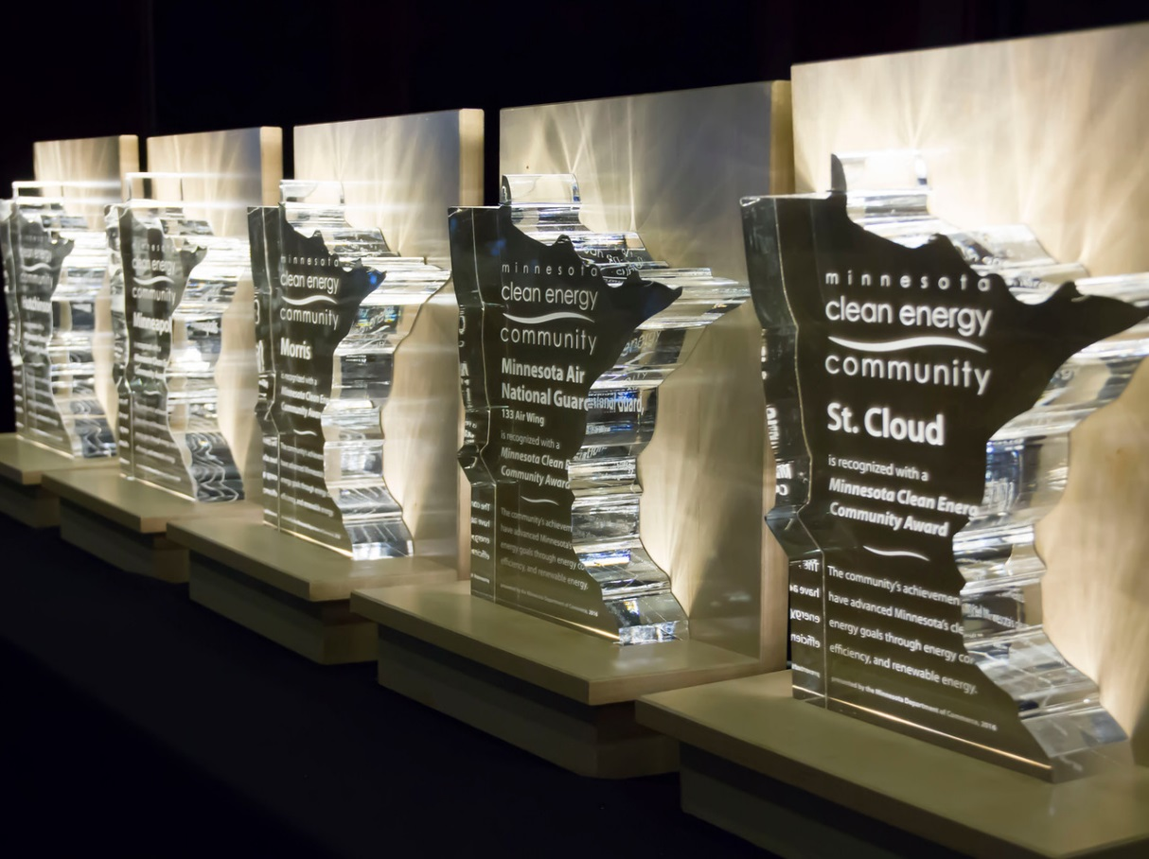
CECA Awards
Achievement Award
Planning Award

Slide 17
CECA Achievement Award
Winners will have implemented programs from among these criteria:
  Planning and policy development that streamlines or enhances reaching goals
  Broad-based partnerships, across several sectors
  Demonstrated success in underserved communities
  Replicable projects and programs

Slide 18
CECA Planning Award
Winners will have had success developing plans and organizing their community to implement clean energy efforts
  Based on the same criteria & possible initiatives as the Achievement Award
  Must include strong initiatives with high likelihood of successful implementation
  Can include initiatives with identified roadblocks, needing additional work or resources to implement

Slide 19
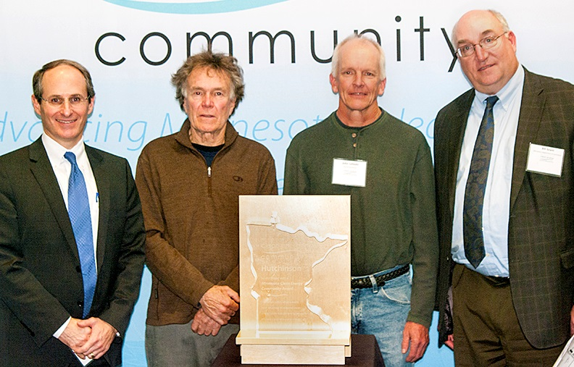
2016 Achievement Awards
City of Hutchinson
Minnesota Air National Guard
133rd Air Wing
City of St. Cloud
City of Minneapolis
City of Morris

Slide 20

2016 Achievement Awards
City of Hutchinson
Minnesota Air National Guard
133rd Air Wing
City of St. Cloud
City of Minneapolis
City of Morris

Slide 21
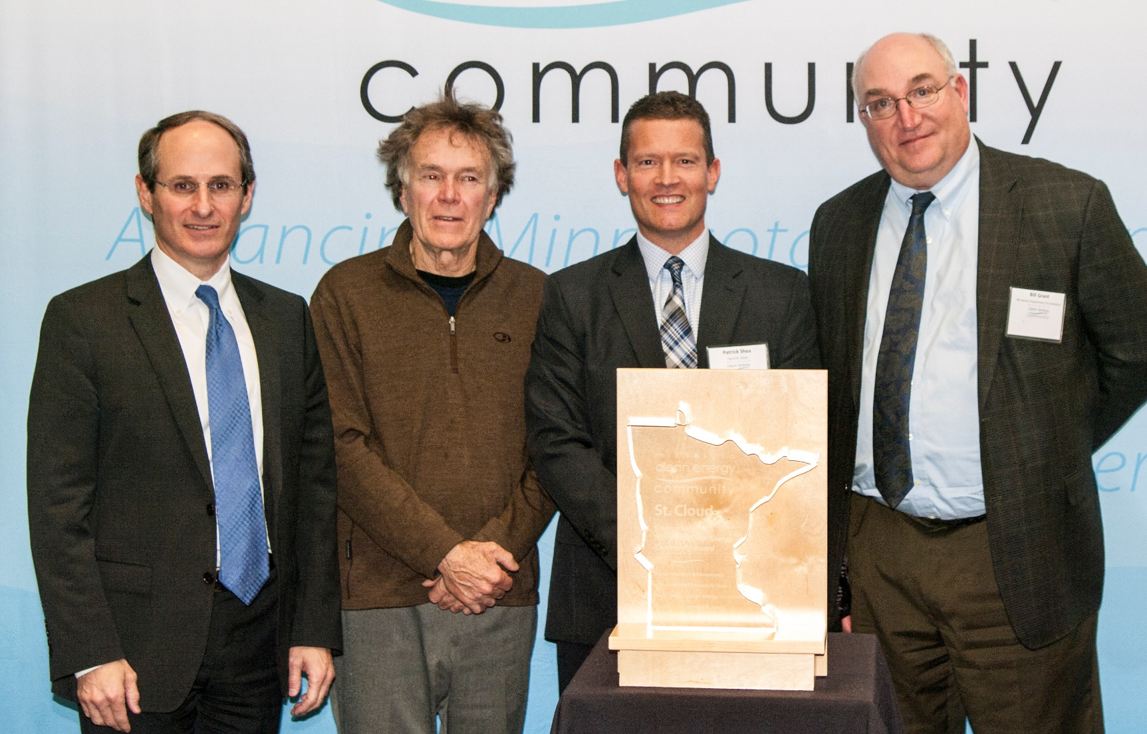
2016 Achievement Awards
City of Hutchinson
Minnesota Air National Guard
133rd Air Wing
City of St. Cloud
City of Minneapolis
City of Morris

Slide 22
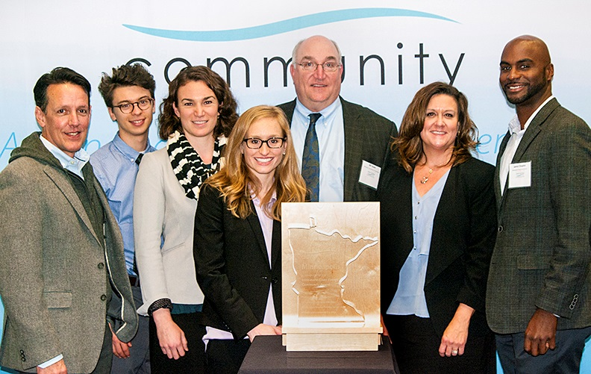
2016 Achievement Awards
City of Hutchinson
Minnesota Air National Guard
133rd Air Wing
City of St. Cloud
City of Minneapolis
City of Morris

Slide 23
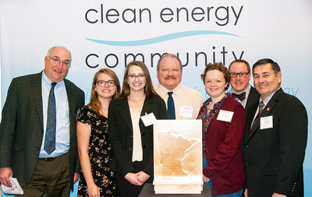
2016 Achievement Awards
City of Hutchinson
Minnesota Air National Guard
133rd Air Wing
City of St. Cloud
City of Minneapolis
City of Morris

Slide 24
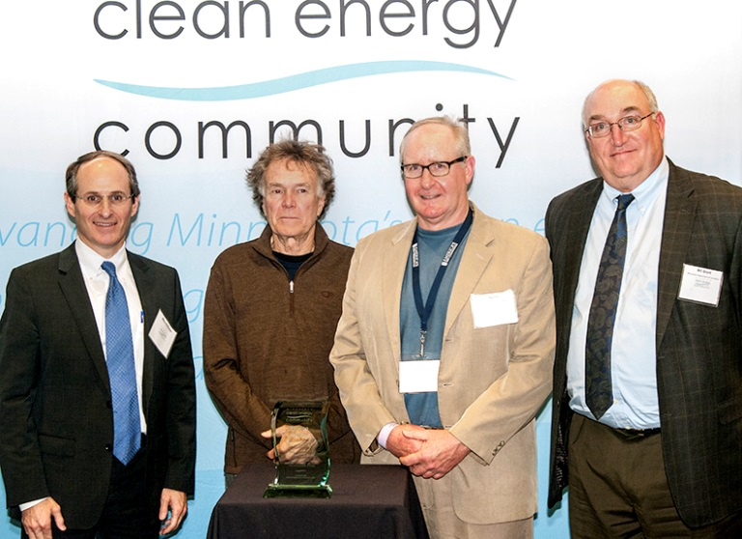
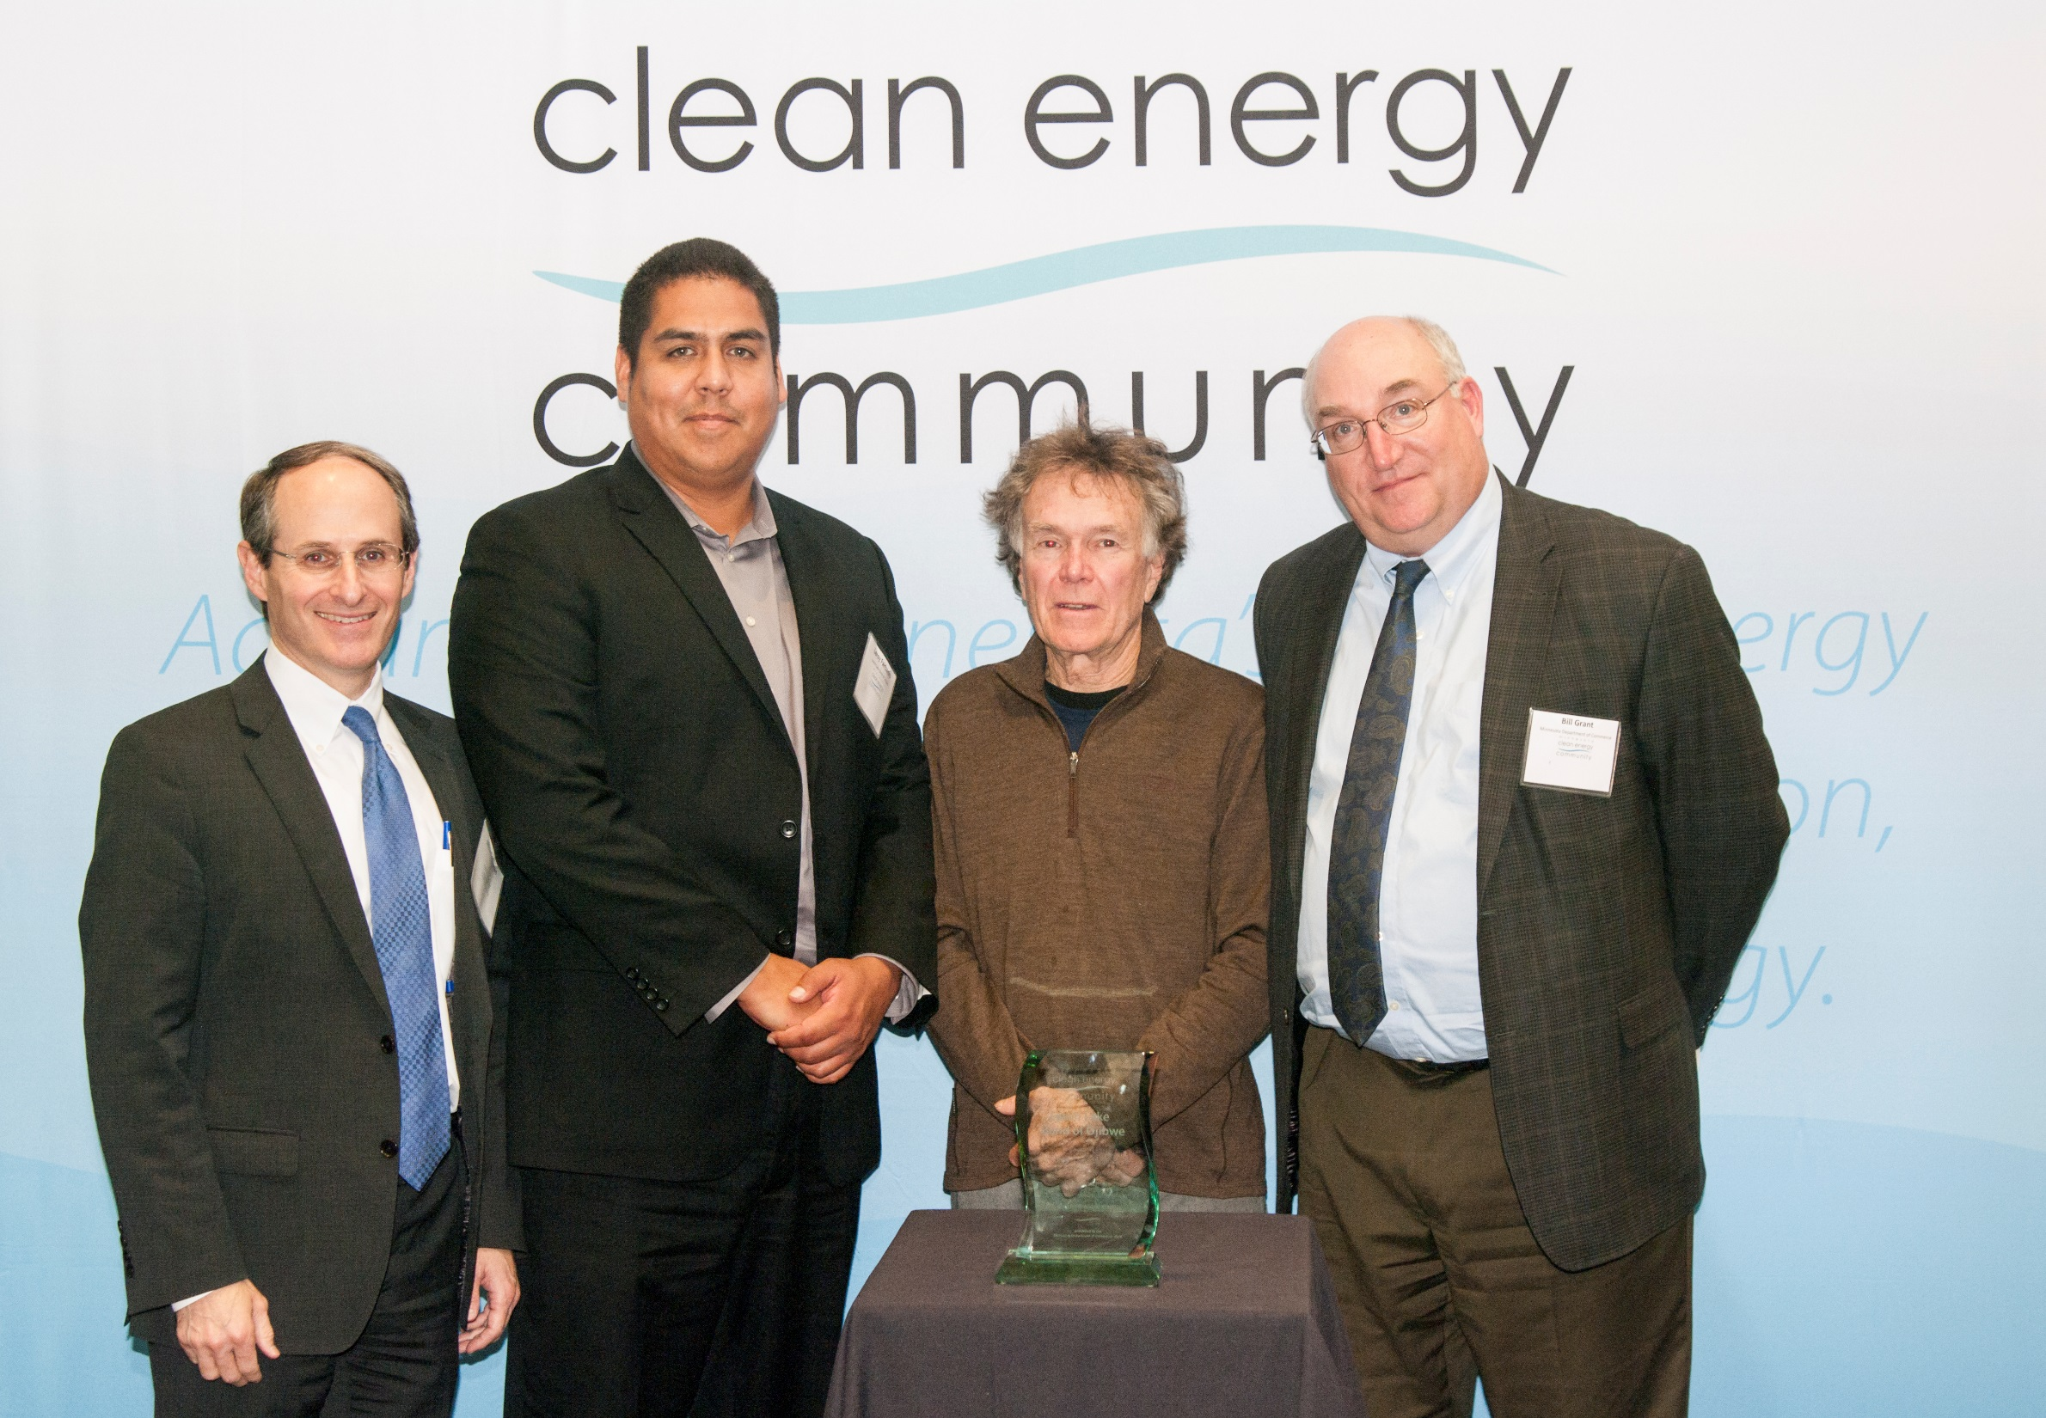
2016 Planning Awards
Cities of Pelican Rapids and Fergus Falls
Chisago County
Leech Lake Band of Ojibwe

Slide 25
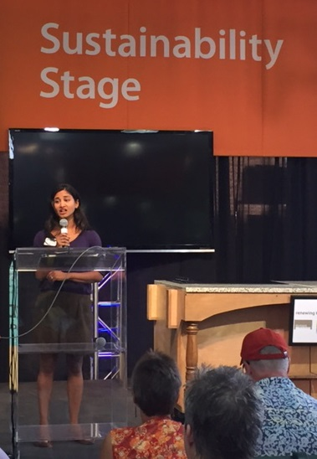
2016 Events
Eco Experience at Minnesota State Fair
  Gate passes for representatives from
  finalist communities
  Public display of program & finalists
  in Commerce’s Energy Exhibit
  Stage recognition
  event for finalist
  communities

Slide 26
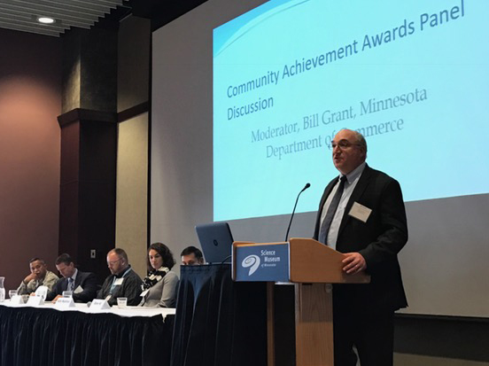
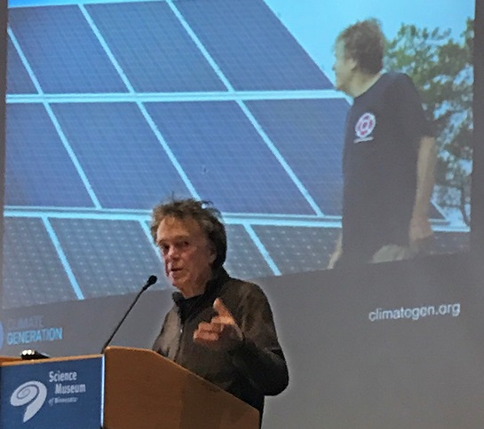
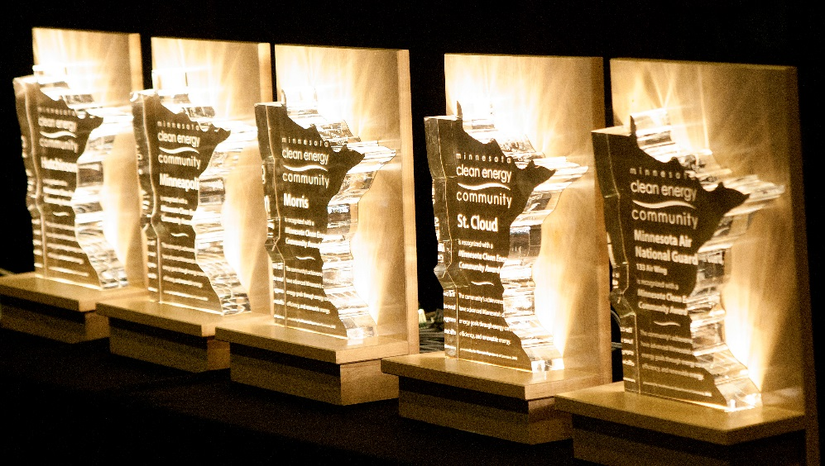
2016 Events
CECA Awards Presentation
    At Science Museum of Minnesota
      Luncheon presentation from Commerce Commissioner Mike Rothman
      Keynote address from Will Steger
      Panel discussion from technical assistance experts
      Panel discussion from
      award recipients
      LED-lit glass awards

Slide 27
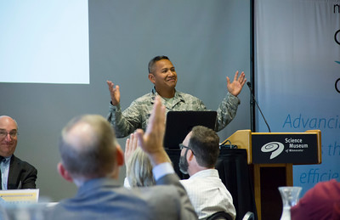
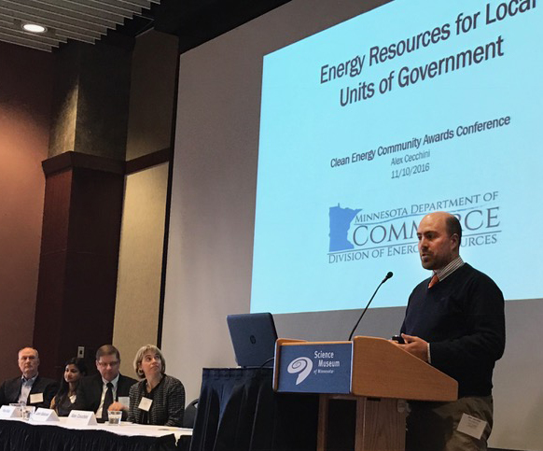
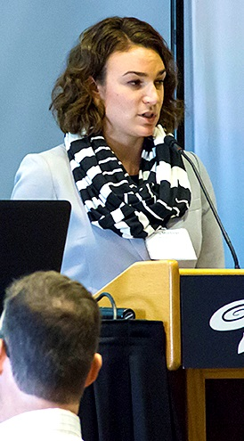
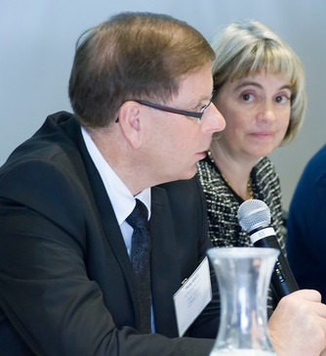
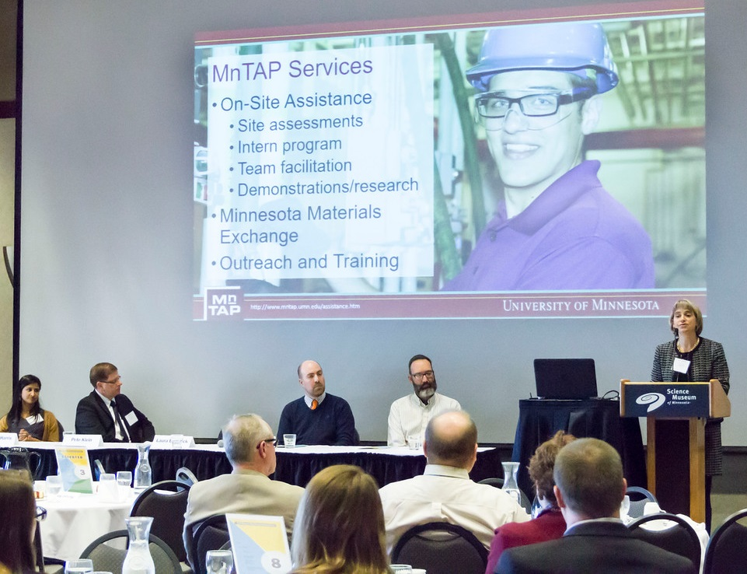

Slide 28
Application Process
  Application information distributed widely
    Commerce e-letters, website, grantees, personal contacts
    Through partner organizations
  Communities apply through online application
  Selection committee reviews applications, makes recommendations
    Broad-based representatives from CECA supporters

Slide 29
2016 support provided by:
The McKnight Foundation
Clean Energy Resource Teams
Climate Generation: A Will Steger Legacy
Great Plains Institute
League of Minnesota Cities
Minnesota Pollution Control Agency
Southwest Regional Development Commission
U.S. Department of Energy;
Office of Energy Efficiency and Renewable Energy
U.S. Environmental Protection Agency; Office of Sustainable Communities
University of Minnesota;
Center for Sustainable Building Research
University of Minnesota;
Institute on the Environment

Slide 30
Application Process
  To learn more:
    energy.info@state.mn.us
    800-657-3710
    You will be added to a distribution list

Slide 31
John Paulson

Slide 32
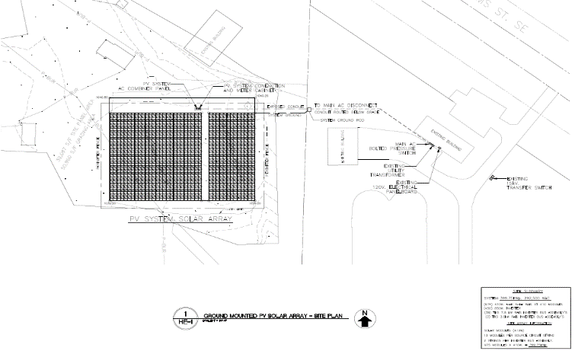

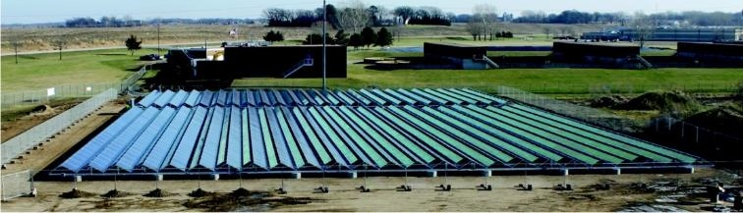
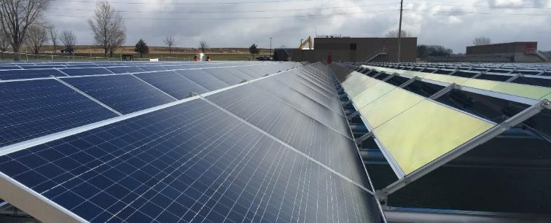
Hutchinson WWTF Solar PV
EP4-41
John Paulson
Project/Environmental/Regulatory Manager
Energy Design Conference & Expo
February 22, 2017

Slide 33
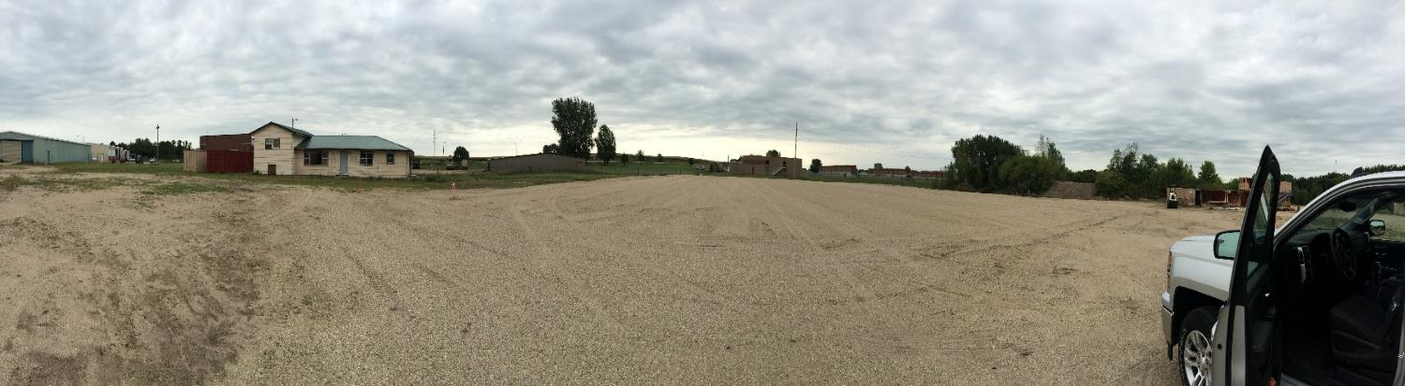
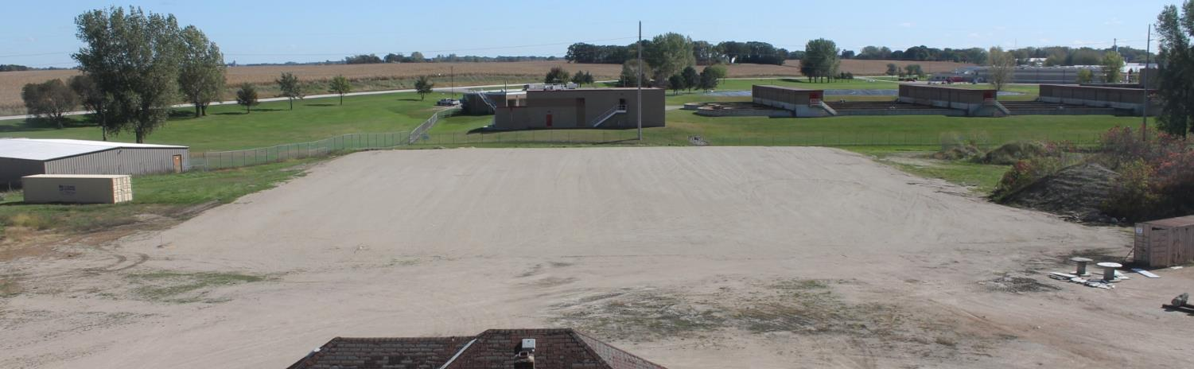

Site Preparation Panoramic
Site Preparation Aerial

Slide 34
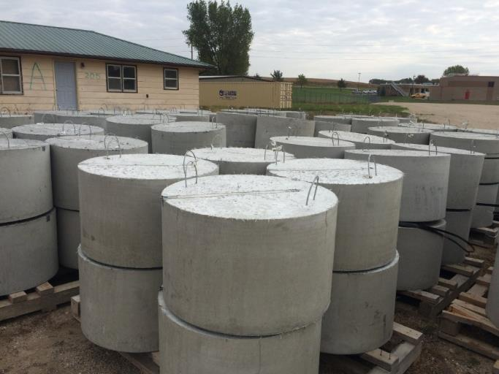
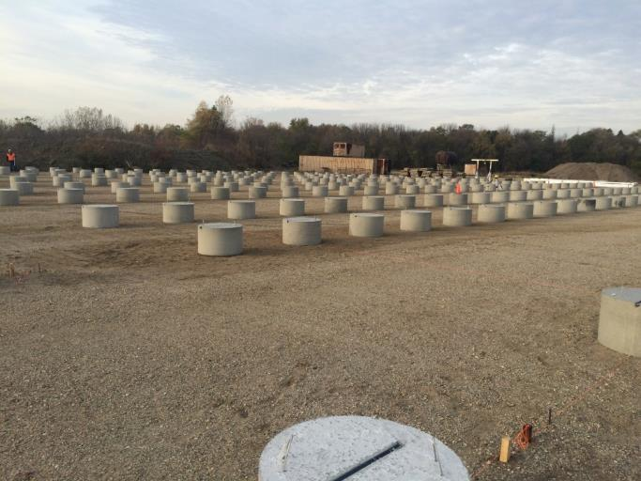
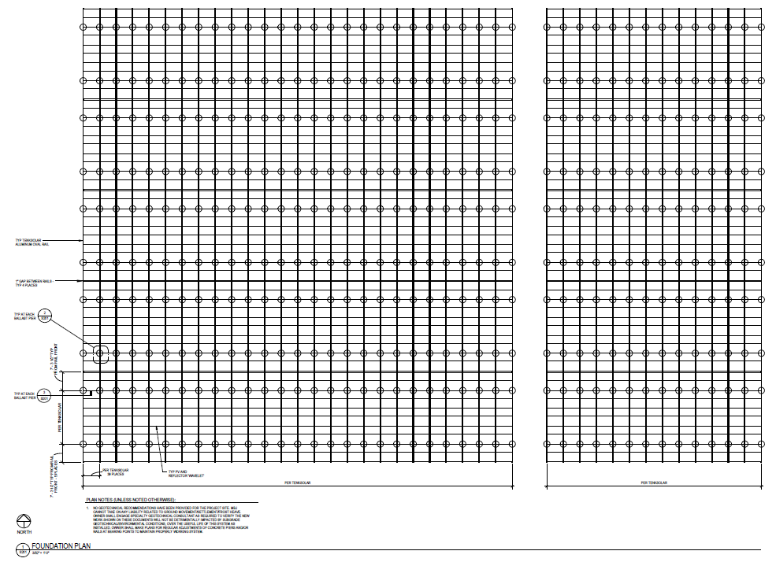
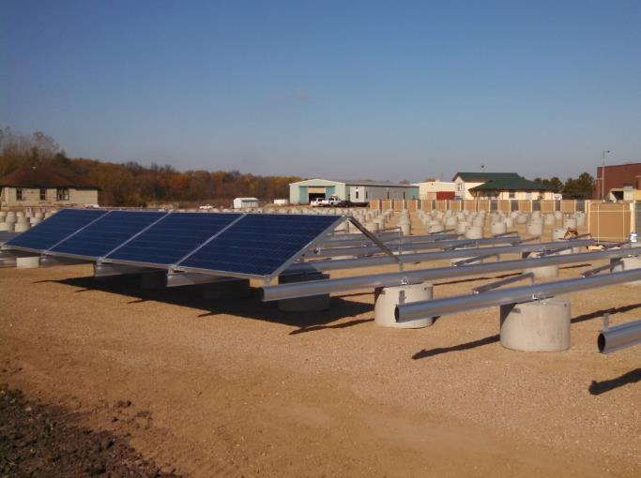
Ballast Piers 18”H x 30”D - 410 total
Pier Layout

Slide 35
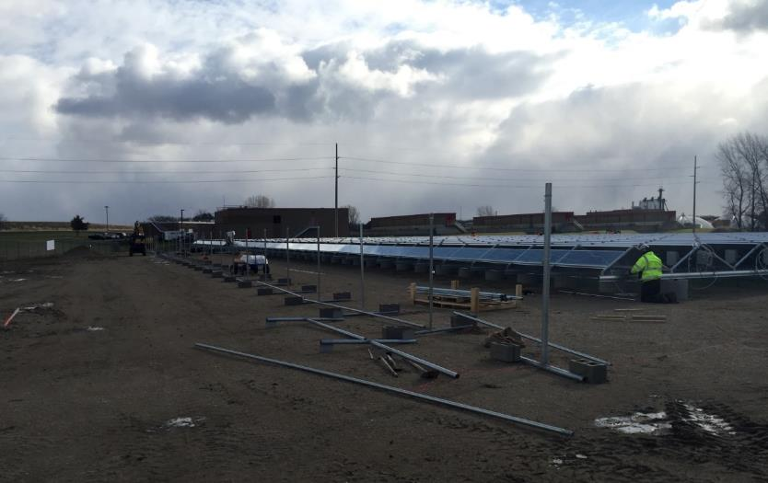
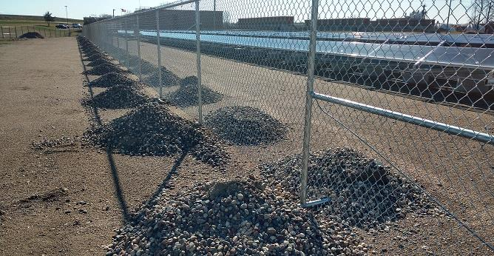
Ballasted Fence Installation
Ballast Material Placed

Slide 36
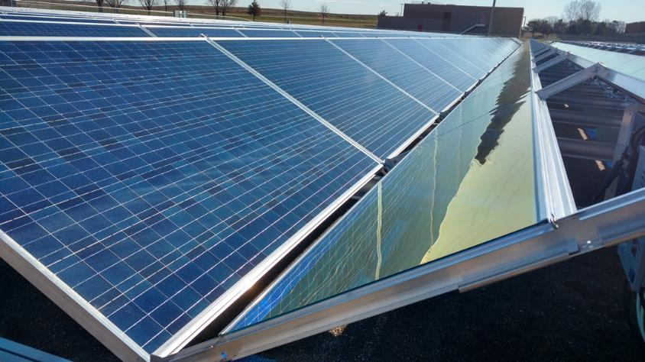
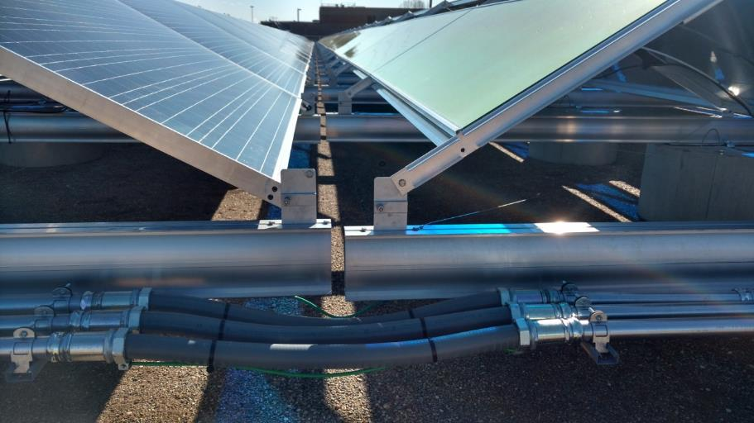
Reflective Panels
Maximize output to minimize area needed
Independent Rails
Allows for minor movement of piers
Includes flexible conduit

Slide 37
City of Hutchinson Solar PV Project History
January 2010: City Council Includes renewable energy in Ends Statement Goals
October, 2011: Westwood: Renewable Energy Suitability Study
June – Sept, 2012: Staff and Council discussions regarding Solar PV project
October, 2012: Signed “Agreement Letter” to Develop a Solar PV System
March 2013: Xcel Energy RDF Proposal Submitted
March 12, 2014: Xcel Award Letter received by the City
April 23, 2014: Planning meeting to move forward
May – September: Updated Xcel Award requirements
    Further developments per the Term Sheet and site requirements
October 14, 2014: Term Sheet executed with AMERESCO
December 23, 2014: Energy Service Agreement w/AMERESCO
June 19, 2015: Xcel Grant Contract approved
October – November 2015: Construction of System 11/25/15 Commissioned

Slide 38
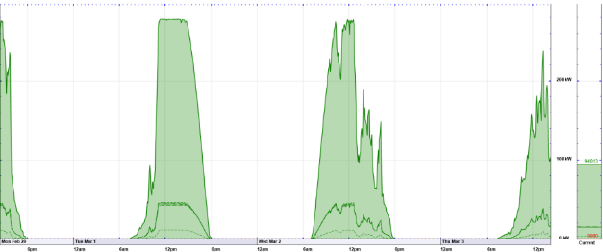
Solar PV Project Specifics
    Solar PV size = 400 KW = 470,070 kwh/year guaranteed (80% derated from actual) (Actual = 587,587 kwh/year) ~15% of the WWTP Annual Load
    E-Gauge continuous monitoring
      Great tool to identify production issues
      Used to track consumption
    Utility costs = 0.737/kwh and annual increases = 1.5%
    Solar System Payback = 18 years (~14 years using higher than guaranteed system output)
    At year 30, system has generated $370,000 – after paying for itself
    Pricing = $1,467,000
      Xcel Grant = $958,360

Slide 39
Solar PV Site Land Use Challenges
        Emergency Services Training Site (Police & Fire)
        Stockpiling Public Works Materials
        State Bonding $ used for improvements 1999
          Office of M&B approval to proceed
          City Dump Site 1950-1980
            Phase I Assessment 1999
            VIC Program April 2002
            Phase II Assessment June 2002
            Additional Assessment September 2002
            Restrictive Covenant July 2007
              No disturbance without MPCA approval
            RAP November 2007
            Solar Project – Construction Contingency Plan & Site Health and Safety Plan

Slide 40
Solar PV Site Land Use Challenges
          RAP and Covenant Requirements
            Construction Contingency Plan
            Site Health and Safety Plan
            Routine inspections of site and LEL monitoring
            NO PENETRATIONS!
            Design Considerations
              Compacted clay fill over existing cover
              Geotextile
              Clean granular over Geotextile
              DIFFERENTIAL SETTLEMENT
                Undisturbed 10 years (Manufacturer White Paper)
                Density Testing

Slide 41


Clean Energy Community Award Project
          Awards Process
            New Awards Program – Didn’t know what to expect
            Simple application process
            Staff prepared application w/internal review feedback
            Project is interwoven into City goals – short and long term
            Benefits
              RECOGNITION FOR YOUR PROJECT/EFFORTS
              Free marketing and awareness of these efforts
              Receive questions by others interested in doing a similar project
                Promotes engagement between agencies to replicate success
                Participate in awards event
                Access to Eco Experience at the State Fair
                Opportunity to network with other communities with similar goals

Slide 42
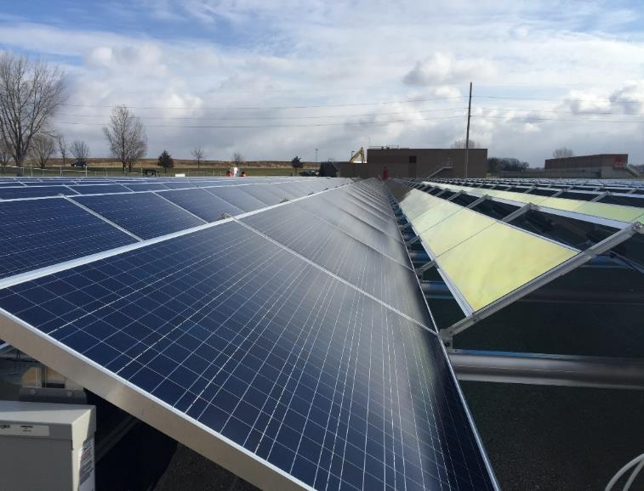

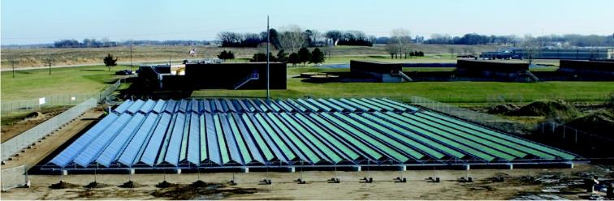

City of Hutchinson
Questions and Comments
(hold until end)
“Project funding provided, in part, by customers of Xcel Energy through a grant from the Renewable Development Fund.”

Slide 43
Fernando Nacionales

Slide 44
133 Airlift Wing
MN Air National Guard
Fernando Nacionales
Deputy Base Civil Engineer

Slide 45
Keys to Success
Leadership Support from DOD down to each shop
Robust Proactive Preventative Maintenance
  Wing Energy Management Plan
  Base Civil Engineer approach
  Engaged Unit Leaders/Building Managers
Technical support/partnerships (CETSC, XCEL, etc)

Slide 46
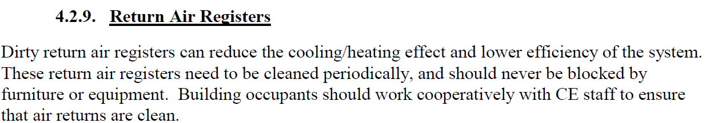
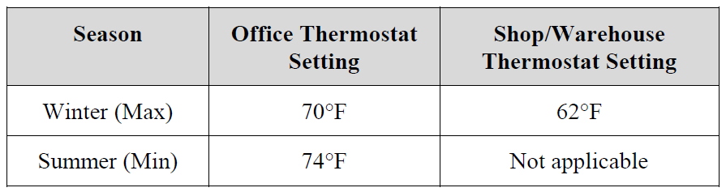
Wing Energy Management Plan
Signed by the Wing Commander
Based on Executive Orders and mandates from higher
Provides actionable directives
Sets achievable goals

Slide 47
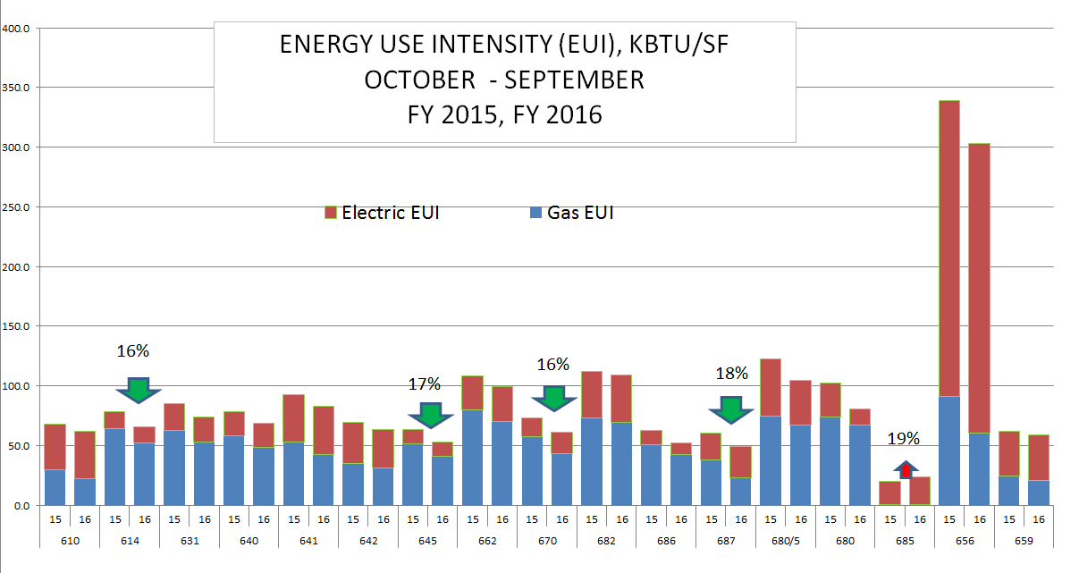
Base Civil Engineer Approach
Building Automation (Direct Digital Control, DDC)
  Uses Wing Management Plan Directives
  Monitors and Optimizes heating and cooling system
  Allows for by-building tracking
Structured Preventative Maintenance Plan
  Integrated Engineering
  Management System (iEMS)
    Tracks PM requirements/schedules
    and more
Quarterly Briefs

Slide 48
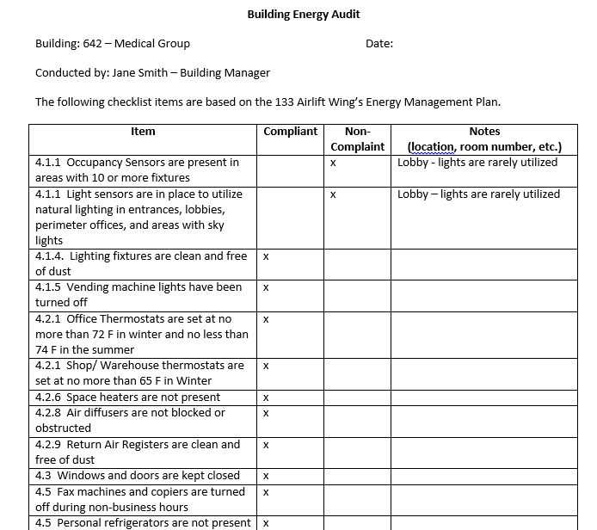
Engaged Unit Leaders/Building Managers
BLDG MGRs are the eyes and ears
Unit Leadership backing is critical
Healthy competition between buildings

Slide 49
What’s Next?
Air Force Institute of Technology (AFIT) Global Photovoltaic Power Potential Laboratory (GP3L) study on pavement PVs
Feasibility study for roof-top and ground PV’s on base
Continued energy-related sustainment projects

Slide 50
Technical Support/Partners
Resource Efficiency Managers (REM)
Civil Engineering Technical Services Center (CETSC)
Air Force Civil Engineer Center (AFCEC)
Utility Partners (Centerpoint, XCEL)

Slide 51
Summary
Keys to Success
  Leadership Support
  Robust Proactive Preventative Maintenance
    Wing Management Plan
    Base Civil Engineer Approach
    Engaged Leaders and Building Managers
  Technical Support/Partners

Slide 52
Patrick Shea

Slide 53



Notes:
(In Progress)

Slide 54
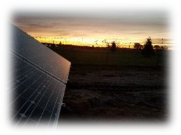

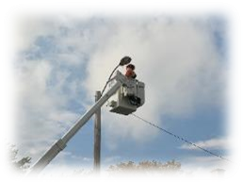
Energy Reduced, Renewable Energy Produced or Solar Energy Purchased
28,300,000 Kilowatt Hours
2,100
Homes’ Electricity
(Use for one year)
21,223,000
Pounds of Coal
47,666,000
Miles Driven
(By a passenger vehicle)
Notes:
Please copy and paste this graphic into slideshow before editing. Graphic is constructed out of movable pieces. This is a smart art graphics. All icons and text are moveable/editable. Click ‘delete’ after selecting an item or items you wish to remove. Quantities text can be edited, however at this stage of our project they do not generate the new information automatically, and all numbers and text must be entered by hand.

Slide 55

2015
2018
5% Renewable
80% Renewable
Conversion TO renewable ENERGY sources

Slide 56

Energy Source | 2015 Totals
Electric | 28,960,526 KWH | $2,937,526
Natural Gas | 551,266 therms | $ 423,705

Slide 57

REEI
Solar Initiative
Energy Efficiency and Biofuel
Energy Action Plan
STREET LIGHT PROJECT
2016

Slide 58

City Owned Street Lights
City Facilities
Smart Street Lights Downtown
Financing

Slide 59
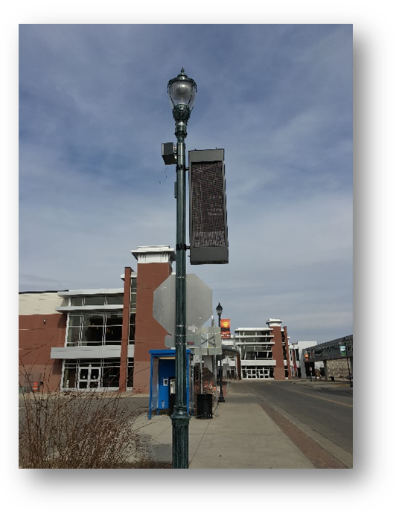
FINANCING
PROJECT DETAILS
Performance Contract
$7.1M Tax Abatement Bond
Project Status – Completion July 2017
$250,000 Energy Rebates (2016 – 2018)
Payback <15 years
Notes:
Icon and photo frame are moving, editable pieces. The delete either, simply click and press ‘DELETE’ You may also delete photo place holder, text boxes, or titles if you desire.

Slide 60
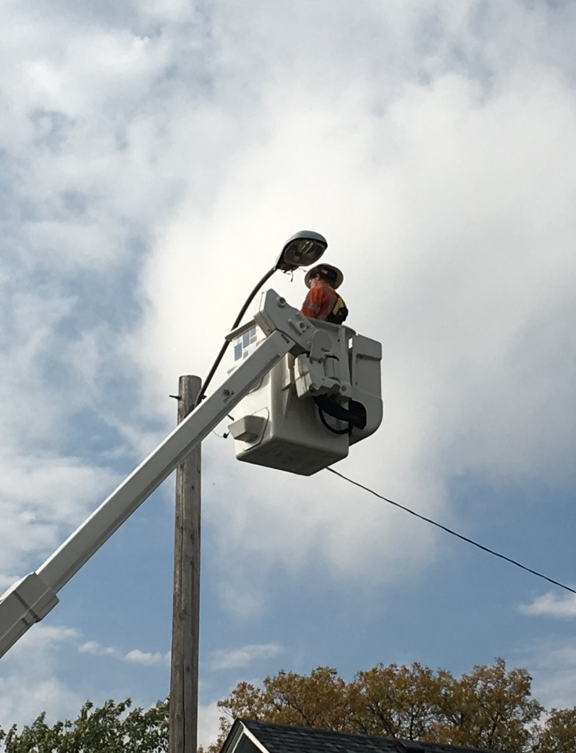
CITY OWNED STREET LIGHTS
PROJECT DETAILS
2,050 Street Lights
48 New or Replaced Services
3,190 Traffic Indicators
525 Pedestrian Crossing Signals
Notes:
Icon and photo frame are moving, editable pieces. The delete either, simply click and press ‘DELETE’ You may also delete photo place holder, text boxes, or titles if you desire.

Slide 61

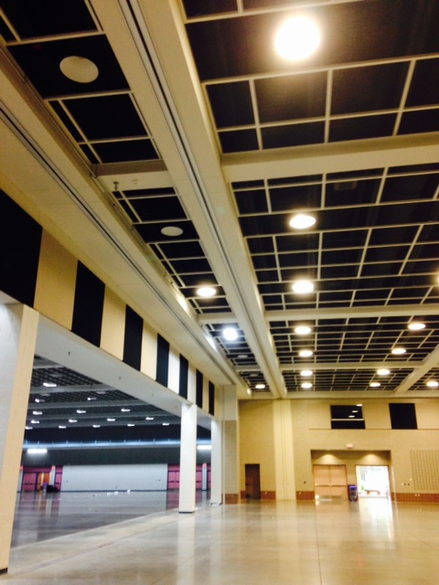
City Facilities
PROJECT DETAILS
9 City Facilities
5 Parking Ramps
Smart Control System
Occupancy Sensors
Daylight Harvesting
Notes:
Icon and photo frame are moving, editable pieces. The delete either, simply click and press ‘DELETE’ You may also delete photo place holder, text boxes, or titles if you desire.

Slide 62
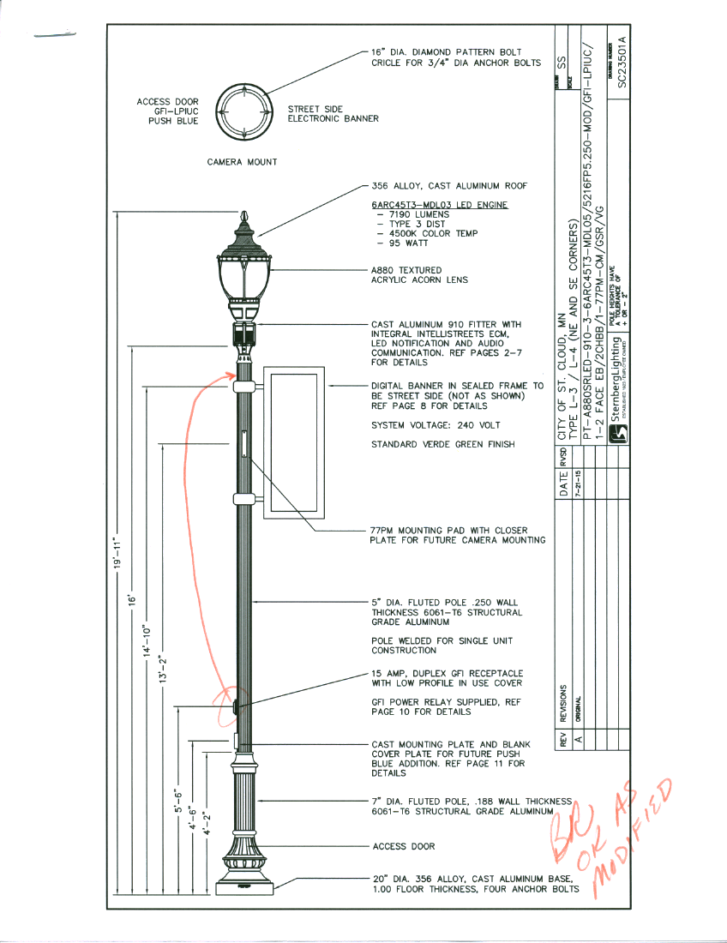
Smart Street Lighting
PROJECT DETAILS
Central Business District
Energy Efficient LED
Announcements and Wayfinding
Synchronized Audio (messaging/music)
Security Enhancements
Notes:
Icon and photo frame are moving, editable pieces. The delete either, simply click and press ‘DELETE’ You may also delete photo place holder, text boxes, or titles if you desire.

Slide 63
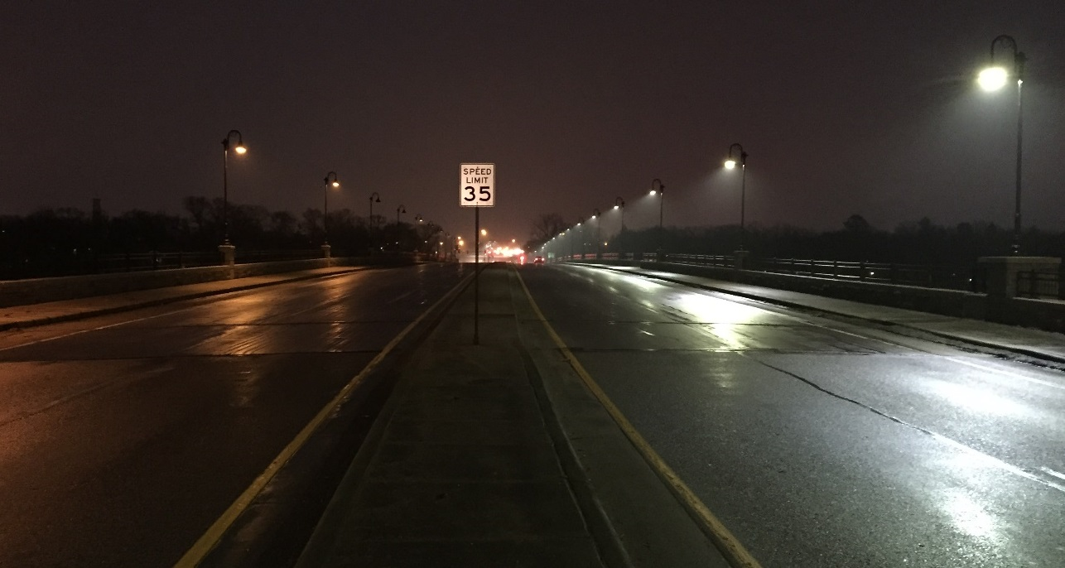
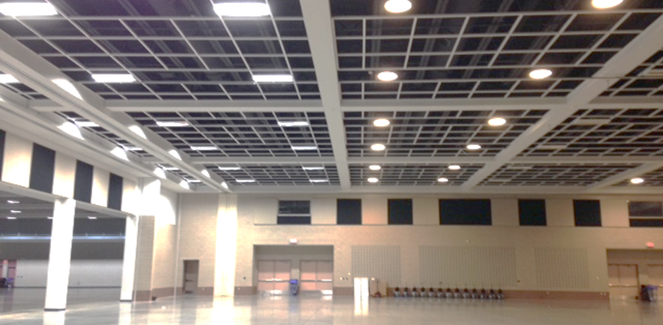

IMPROVEMENT PROJECT
Light Quality Improvement
40% More Efficient
Reduced O&M

Slide 64
Street Light Improvement Project Energy Savings
2,873,000 Kilowatt Hours
258
Homes’ Electricity
(Use for one year)
2,130,760
Pounds of Coal
4,737,971
Miles Driven
(By a passenger vehicle)
Notes:
Please copy and paste this graphic into slideshow before editing. Graphic is constructed out of movable pieces. This is a smart art graphics. All icons and text are moveable/editable. Click ‘delete’ after selecting an item or items you wish to remove. Quantities text can be edited, however at this stage of our project they do not generate the new information automatically, and all numbers and text must be entered by hand.

Slide 65












Project partners

Slide 66
Questions?

Slide 67
To learn more:
energy.info@state.mn.us
800-657-3710
  You will be added to a distribution list

